Slide 1

Time Series Deep Dive
By Kelsey Emnett

Slide 2
Links
Files located here: bit.ly/machine-learning-introduction in Class 12 folder
Class videos will be posted by the Sunday after class on my website www.kelseyemnett.com and my YouTube channel https://www.youtube.com/channel/UCR7ejcDyKykQ3wE-KS08Smg.

Slide 3
Class Machine Learning Example
Data:
Trying to Measure:
Goal:
Rossmann store sales
Trends, patterns, and seasonality over time
Understand past and current trends and forecast the future
Rossmann Store Sales Link
3

Slide 4
Overview of Time Series Analysis

Slide 5
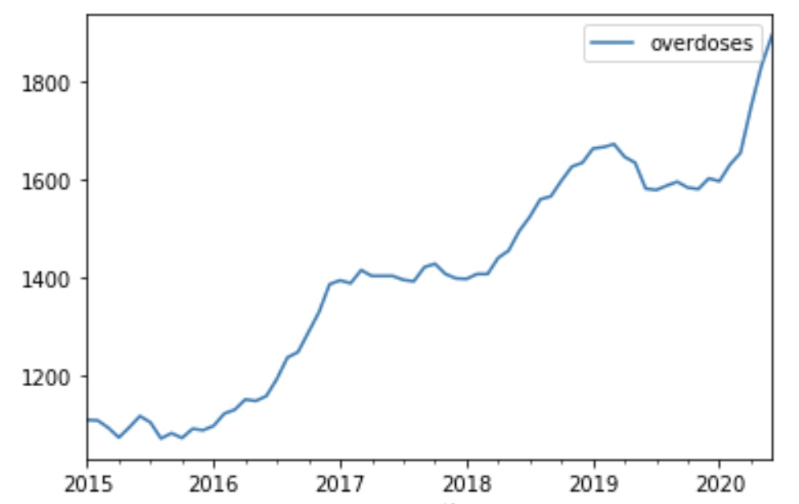
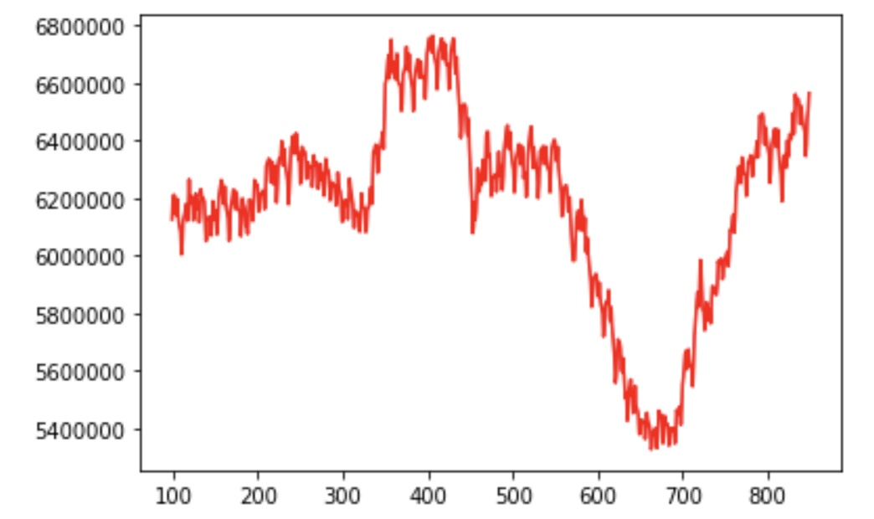
Time Series Modeling
Missouri Drug Overdoses
According to Practical Time Series Analysis, “time series analysis is the endeavor of extracting meaningful summary and statistical information from points arrange in chronological order”.
Why not use regression?
  Regression assumes independence of observations
  Previous data points will be similar to future data points
Rossmann Store Sales

Slide 6
Time Series Use Cases
Forecasting future sales and transactions
Understanding historical credit card application trends, seasonality, and events such as holidays
Detect anomalies to:
  Predict machinery malfunctions (predictive maintenance) with IoT devices
  Forecasting sales or product supply
  Detecting trend changes and outliers in stock sales

Slide 7
Characteristics of Time Series

Slide 8
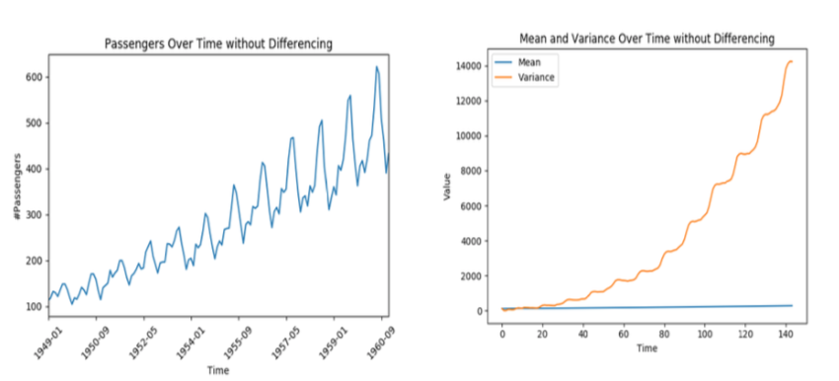
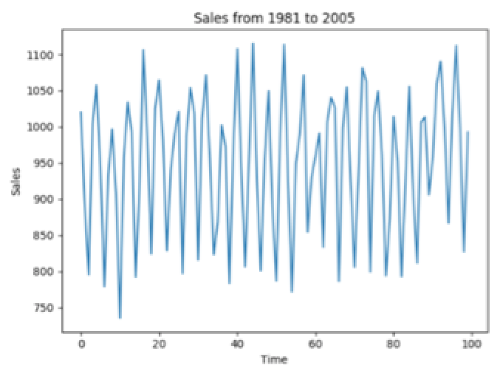
Stationarity
Stationarity: Assumption of some time series methods that statistical properties of a system stay static over time
  If the time series was broken into equally sized chunks, it would still have the same probability distribution
  Exhibits no trends or seasonality
  Shows a constant mean and variance
Not Stationary
Stationary

Slide 9
Stationarity Requirement
The presence or absence of these patterns in your data determine which modeling method is best
To use most traditional statistical time series data, the data needs to be stationary
  Need stationary data to run autoregressive (AR), moving average (MA), ARMA, and ARIMA models
If your data is not stationary, can sometimes use differencing to make it stationary
1st Differencing: Taking the current time period minus the previous time period
2nd Differencing: Differencing using the results of 1st differencing procedure

Slide 10
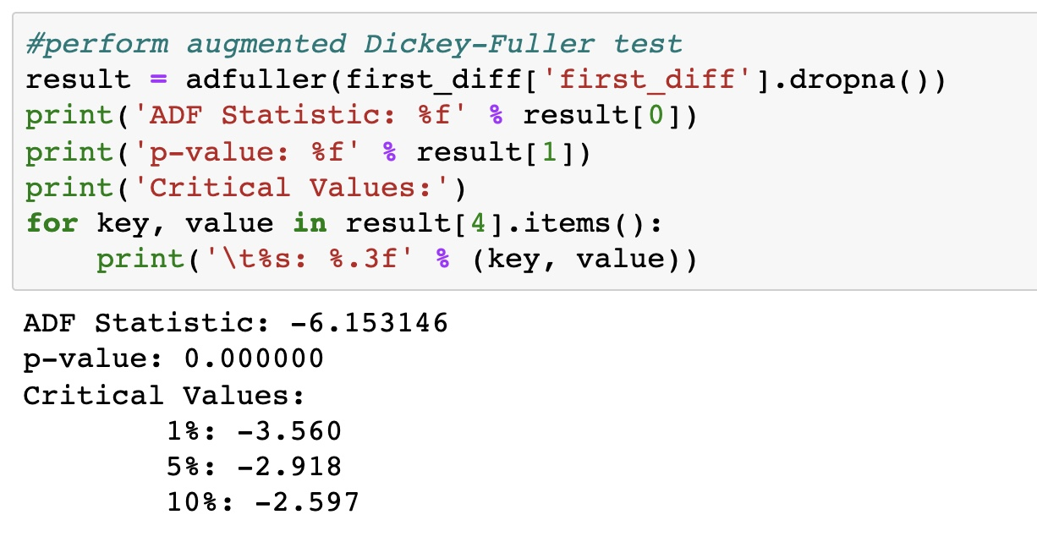
Testing for Stationarity
To test for stationarity mathematically can use a Dickey-Fuller test
Uses an auto-regressive model and tests for stationarity across multiple lag values
Null hypothesis is that a data set is not stationary
If the p-value is significant, we can reject the null hypothesis and assume that the data is stationary

Slide 11
Autocorrelation
Autocorrelation: Correlation between two data points at different positions in a time series
Autocorrelation is measured in lags or the number of intervals between two points in a time series
  For example, the lag between the current point and two points prior is 2
Examining autocorrelation plots can help uncover stationarity, seasonality, and trends

Slide 12
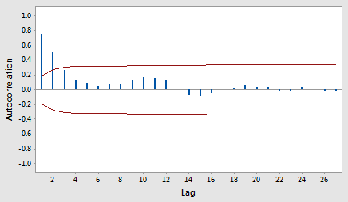
Autocorrelation (ACF) Plots: Stationary
Bars outside the red lines have autocorrelation that is significant
If there is a significant autocorrelation, indicates you need a model with lags
Stationary time series have autocorrelation that declines to zero quickly

Slide 13
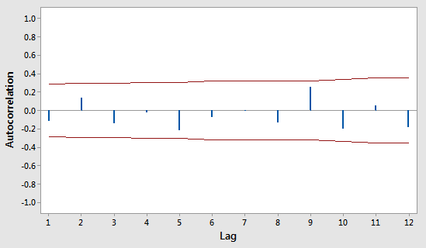
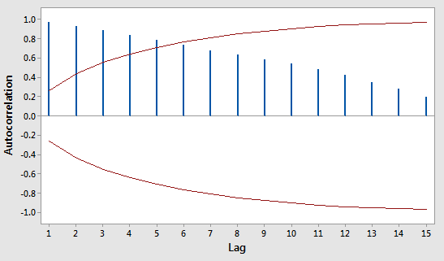
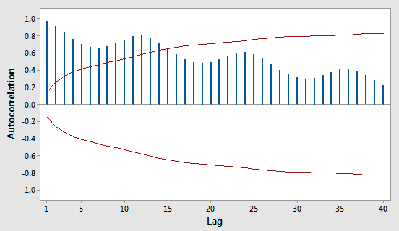
Autocorrelation (ACF) Plots: Not Stationary
Random
Trend
Seasonality
Points are not correlated with previous points
Use regression not time series
Correlation gradually decreases with each additional lag
Demonstrates a trend and the data is not stationary
Bars oscillate with a consistent a pattern
Demonstrates seasonality and the data is not stationary

Slide 14
Seasonality and Trends
What if you cannot achieve stationarity?
  Usually occurs when a trend or seasonality exists
Need to use a model that accounts for seasonality and/or trends
If is no trend but seasonality exists: Can use SARIMA models
  Uses an ARIMA model that accounts for seasonal trends
If there is a trend and seasonality need to use a model that accounts for both
  Today we will cover Meta/Facebook Prophet models an option for this type of analysis

Slide 15
Data Preparation

Slide 16
Missing Value Imputation
Forward Fill: Carry forward the last known value prior to the missing value
  Should not be used for forecasting/prediction
Backward Fill: Fill in data backward with the nearest known data point
Moving Average: Rolling median or average with multiple data points before or after the missing data point
  Exponentially weighted moving averages can be used if you want to give more weight to nearer data points

Slide 17
Other Preprocessing Methods
Data Aggregation: Aggregating your data at a different level than measured
  Why?
    Multiple groups such as locations or stores may not have the same tracking frequency
    May decrease noise and make predictions more accurate
Smoothing Data: Reduces random variation and exposes the structure of the underlying data to improve predictions
  Also useful for visualizing time series

Slide 18
Time Series Pitfalls: Lookaheads
Lookahead: When a model relies on data not available or known during the time period being modeled
Issues causing lookaheads:
  Smoothing using data outside of the training period
  Imputing missing data using data outside the training period
If your model has a lookahead, the model accuracy may be inflated

Slide 19
Facebook Prophet Models

Slide 20

Prophet Models
Systematic components: Components of time series with consistency or recurrence
  Daily, weekly, and yearly seasonality
  General movement or trends over time
Non-systematic components: Random error or noise that cannot be directly modeled (residuals)
Accounts for:
  Seasonality
  Trends
  Holidays
  Changepoints
  Extra regressors
Sum of three functions: Growth, seasonality, holidays, and an error term

Slide 21
Trend: Growth Functions
Prophet provides three choices for growth functions:
  Linear growth: Specifies a piecewise linear equation (think y = mx + b) with differing slopes between changepoints
  Logistic growth: Good for cases with a cap or a floor on the possible model values
  Flat: Can specify a flat trend with no growth over time
Set with growth parameter in Prophet function

Slide 22
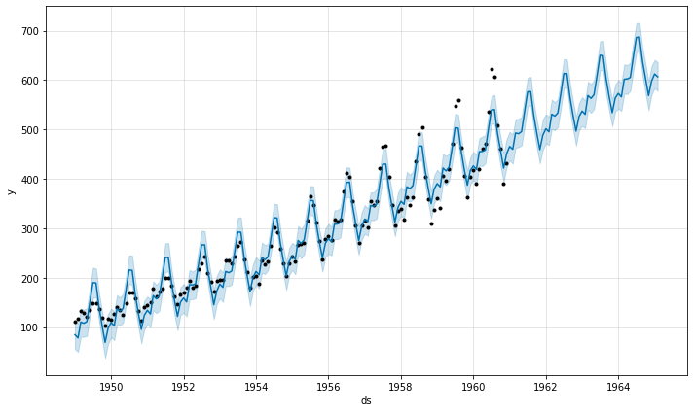
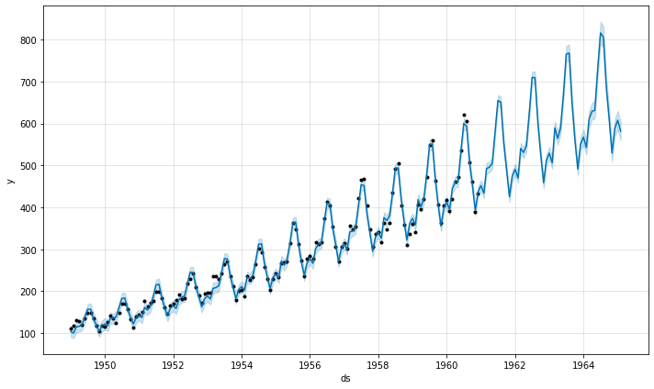
Seasonality: Additive vs. Multiplicative
Additive Seasonality
Seasonality/cyclical patterns are created by a Fourier Series curves
  Made up of sine and cosine curves multiplied by coefficients
Seasonality can be specified as multiplicative or additive:
  Additive: Seasonality is added to the trend
    Use if the peaks and troughs have roughly the same size
  Multiplicative: Seasonality grows with the trend
    Use if you have increasing or changing seasonality
Set with growth parameter in Prophet function
Multiplicative Seasonality

Slide 23
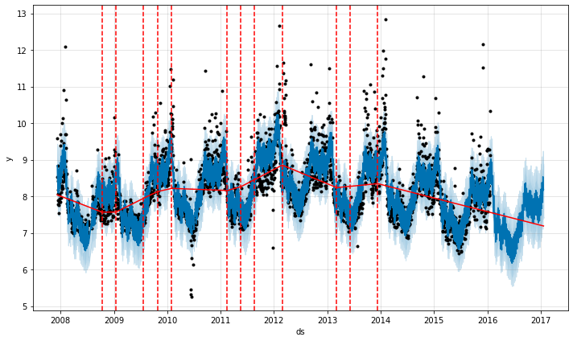
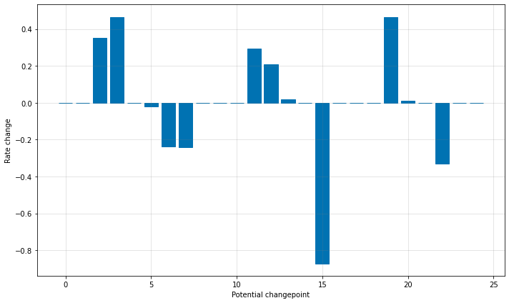
Changepoints
Prophet performs automated changepoint detection
Changepoints: Abrupt changes in the trajectory or trend of the time series
How?
  Specifies a large number of potential changepoints where the model allows the growth rate to change
  Automatically detects significant changepoints
  The user can also manually select changepoints
  Dashed lines on the right show detected changepoints

Slide 24
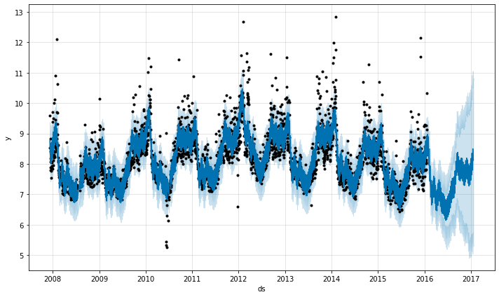
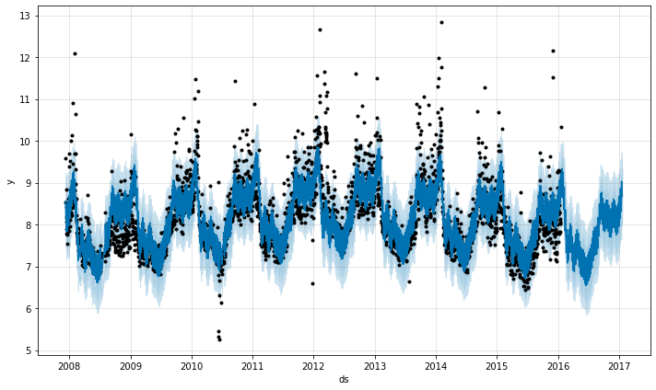
Regularization
Can change the prior scale parameter (changepoint_prior_scale) to make the trend more flexible
Default is set as 0.05 and has a maximum of 1
  The higher the value, the more flexible the trend
  Decreases overfitting
Decreasing Flexibility

Slide 25
Customization: Holidays and Regressors
Holidays
  Can specify holidays and/or events and windows surrounding them to measure the recurring holiday effect
  Have the option of using built-in country holidays or custom holidays/windows can be specified
Regressors
  Can specify additional variables to control for confounding factors
Custom seasonality
  In addition to standard daily, weekly, and yearly seasonality you can also specify custom seasonality

Slide 26
Customization: Other Arguments
add_country_holidays: Add holidays of a specific country
holidays: Set custom holidays
  Will not work with add_country_holidays specified
changepoints: Provide custom changepoints to model
changepoint_range: Sets the percentage of data in which trend changepoints are estimated
  Note: Too many changepoints can cause overfitting
changepoint_prior_scale: Sets the flexibility of automatic changepoints detection
growth_floor and growth_cap: Used with logistic growth models, sets minimum and maximum that the model can reach
More model parameters can be found here

Slide 27
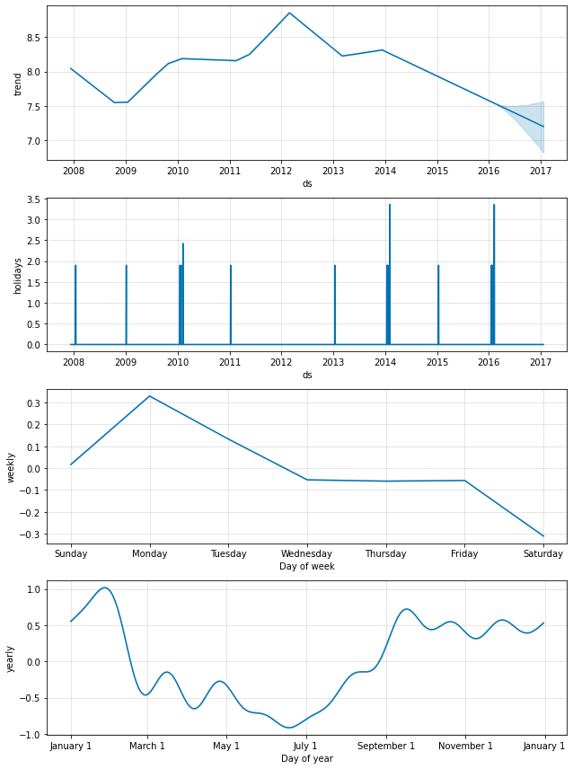
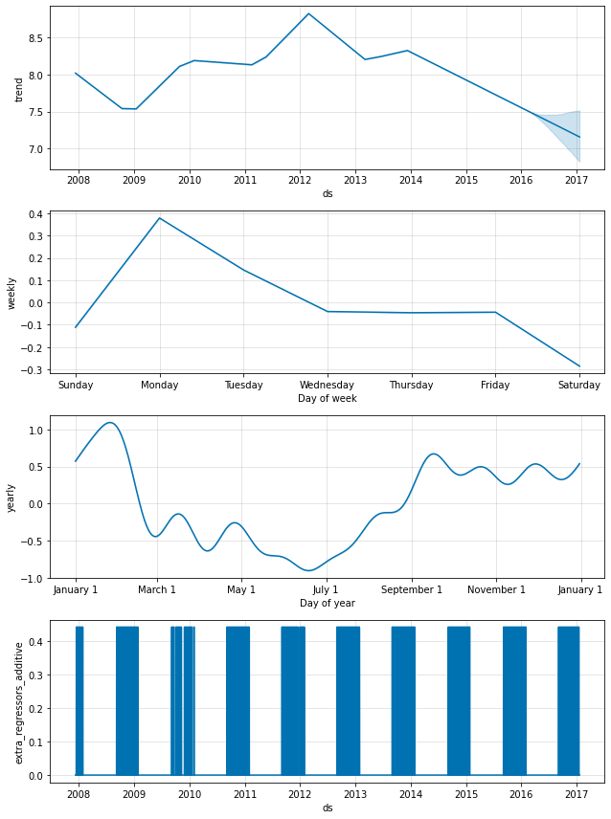
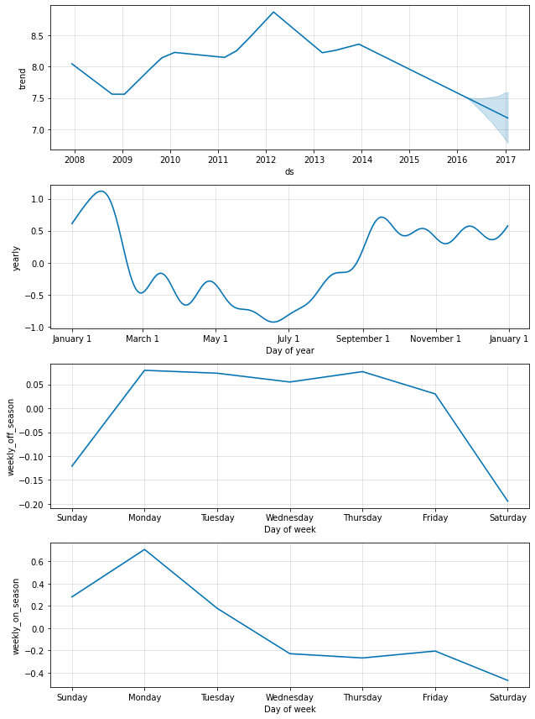
Example: Page Views of Peyton Manning Wikipedia
Holidays: Playoffs & Superbowl
Regressors: NFL Sundays
Seasonality: On/Off Season

Slide 28
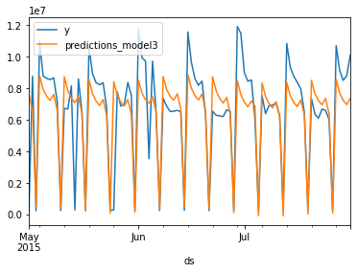
Time Series Model Validation
The most typical approach is to split the data into training, validation, and holdout data sets
The most recent values are often used as the validation data set
Judge performance based on “unseen” data
  Use metrics such as mean absolute error, mean squared error, etc.
Actual
Predicted
MSE: $3,757,869,972,817
MAE: $1,276,182
MAPE: 1.13%
Average daily sales are $6,234,798. Not a good model!!

Slide 29
How Can Prophet Be Used
Prophet and other time series models are useful for more than just forecasting
Helpful for understanding:
  Outliers or abrupt changes from trends
  Seasonality
  Holiday effect
Examples:
  Understanding holiday effect or impact of severe weather on sales
  Account for seasonality when performing outlier detection
  Forecast product supply or sales in order to adjust staffing

Slide 30
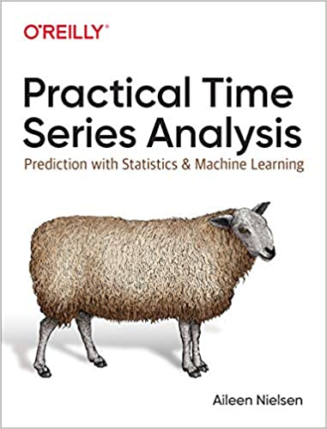
Time Series Resources
General Time Series Resources
https://otexts.com/fpp2/index.html
https://towardsdatascience.com/time-series-from-scratch-decomposing-time-series-data-7b7ad0c30fe7
MA, AR, ARMA, and ARIMA Models
https://predictivehacks.com/arima-model-in-python/
https://machinelearningmastery.com/make-sample-forecasts-arima-python/
https://towardsdatascience.com/time-series-forecasting-arima-models-7f221e9eee06#:~:text=Stationary%20time%20series%20is%20when,when%20the%20series%20is%20stationary.&text=Autocorrelation%20refers%20to%20how%20correlated,and%20including%20the%20lag%20unit.
https://towardsdatascience.com/defining-the-moving-average-model-for-time-series-forecasting-in-python-626781db2502
https://www.geeksforgeeks.org/python-arima-model-for-time-series-forecasting/
Data Visualization
https://machinelearningmastery.com/time-series-data-visualization-with-python/

Slide 31
Time Series Resources
Time Series Assumptions
https://analyzingalpha.com/stationarity
https://statisticsbyjim.com/time-series/autocorrelation-partial-autocorrelation/#:~:text=Autocorrelation%20is%20the%20correlation%20between,values%20influence%20the%20current%20value.
https://analyticsindiamag.com/an-overview-of-autocorrelation-seasonality-and-stationarity-in-time-series-data/
https://www.influxdata.com/blog/autocorrelation-in-time-series-data/
https://towardsdatascience.com/identifying-ar-and-ma-terms-using-acf-and-pacf-plots-in-time-series-forecasting-ccb9fd073db8
https://analyticsindiamag.com/complete-guide-to-dickey-fuller-test-in-time-series-analysis/
Prophet
https://pythondata.com/forecasting-time-series-data-prophet-trend-changepoints/
https://towardsdatascience.com/time-series-analysis-with-facebook-prophet-how-it-works-and-how-to-use-it-f15ecf2c0e3a
https://www.analyticsvidhya.com/blog/2018/05/generate-accurate-forecasts-facebook-prophet-python-r/

