Slide 1

Careers in Data Science
By Kelsey Emnett

Slide 2
Links
Files located here: bit.ly/machine-learning-introduction
Class videos will be posted by the Sunday after class on my website www.kelseyemnett.com and my YouTube channel https://www.youtube.com/channel/UCR7ejcDyKykQ3wE-KS08Smg.

Slide 3


My Background
Six years of experience in data science and analytics in incentives, retail, pharmaceuticals, and more
Manager/ Leader
Individual Contributor

Slide 4
Working as a Data Scientist
Goal: Solving business problems with modeling
Day-to-day activities
Difficulties and challenges
Focus on continuous learning and growth

Slide 5
Prioritization of Skills
Essential Skills
Machine learning and modeling
  Primary focus on: Linear/logistic regression, KNN, and tree-based models first before moving onto more difficult models
  Secondary focus on: Unsupervised learning, deep learning, & time series
Python coding
SQL
Communication skills
Advanced Skills
PySpark
Cloud solutioning (Azure, GCP, and/or AWS)

Slide 6
My Learning Path

Slide 7
Learning Process
Find the best way you personally learn
  For me it was books, for you it may be videos
Process
  Read about a model a selection of books (shown on next slide)
  Supplement knowledge where necessary for specific topics with web sources (see https://kelseyemnett.com/2020/05/25/machine-learning-links/)
  Choose a data set you are interested in and code out the models yourself in Python

Slide 8
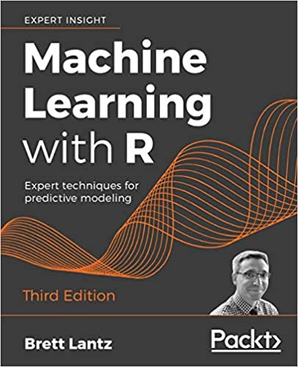
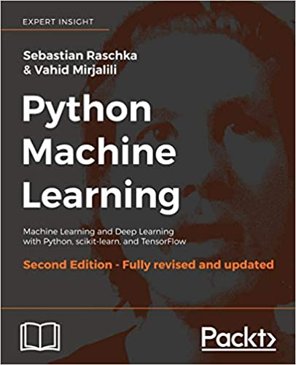
Books of Choice
First Stop
Second Stop
Good high-level overview
Not detailed enough for a one-stop-shop
Pay attention to concepts not code
More math-heavy than the R book
Good as a second, more complex pass for each model

Slide 9
Learning to Code
Chose Treatment Episode Data Set to practice machine learning models I learned
Iterated on the models for many years as I learned new techniques
See the Github for my machine learning classes for full walk-throughs: https://github.com/kelsey-huntzberry/DataAnalysisLab/tree/master/Machine_Learning_for_Beginners

Slide 10
Questions?

