Slide 1

Machine Learning for Beginners: Class 6
By Kelsey Emnett

Slide 2
Links
Files located here: bit.ly/machine-learning-introduction
Class videos will be posted by the Sunday after class on my website www.kelseyemnett.com and my YouTube channel https://www.youtube.com/channel/UCR7ejcDyKykQ3wE-KS08Smg.

Slide 3
Class Machine Learning Example
Data:
Trying to Predict:
Goal:
Includes every admission to a substance abuse treatment center that is publicly funded by the government
Which admissions are ”first time admissions” and which were “repeat admissions”
To predict which individuals are at high risk for relapse upon admission to a substance abuse treatment facility
Treatment Episode Data Set Available Here
3

Slide 4
Decision Trees Review

Slide 5
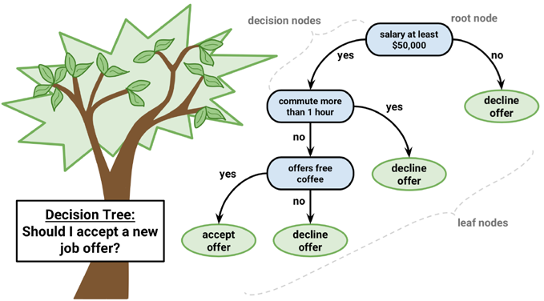
Decision Trees Overview
A Decision Tree model is a classification model
It splits your data points into progressively smaller groups based on a series of yes or no questions from the model’s features
  Questions can be based on categorical or numeric variables
Questions follow a tree-like structure
Image Source: Machine Learning with R, 3rd Edition by Brett Lantz

Slide 6
Decision Trees Structure
Decision trees use the following structure:
  The root node is the first node that begins the decision tree
  The data flows through decision nodes where your data is narrowed down into progressively smaller, more specific groups
  Leaf nodes or terminal nodes are the final prediction based all of the yes or no questions asked in prior levels
Image Source: Machine Learning with R, 3rd Edition by Brett Lantz

Slide 7
Decision Tree Hyperparameters
Hyperparameters | What It Does | How It Helps
Max Depth | The maximum depth (i.e. number of levels) of a tree based on | Decreasing this number reduces overfitting
Minimum Samples Per Split | The minimum number of observations for a split on a decision node to occur | Increasing this number reduces overfitting
Minimum Samples Per Leaf | The minimum number of observations in a final leaf node | Increasing this number reduces overfitting
Minimum Weighted Fraction Per Leaf | Fraction of total samples required to be in a leaf node. If a sample weight is provided, it will give values in the numerator higher weight if sample weight is higher. | A higher value reduces overfitting. Sample weights also help when there is class imbalance by giving less weight to the dominant class.
Maximum Features | Sets the maximum number of features to consider when looking for the best split | Decreasing this number will reduce overfitting
Maximum Number of Leaf Nodes | Sets a maximum number of leaf nodes in final model | Decreasing this number will reduce overfitting
Minimum Impurity Decrease | Minimum amount that the impurity can decrease to make a split | Increasing this number will reduce overfitting
Source: https://scikit-learn.org/stable/modules/generated/sklearn.tree.DecisionTreeClassifier.html

Slide 8
Ensemble Methods

Slide 9
What Are Ensemble Methods?
A decision tree is an example of a ”weak learner”
  Tends to be less accurate because of its tendency to overfit
Often it is better to combine many “weak learners” together to get a better ”ensemble” model
Types of ensemble methods
  Bagging (or bootstrapping): Repeatedly run a model and average together the results
  Boosting: Models are built sequentially and each model tries to further reduce the bias seen in previous models
  Stacking: Multiple types of models are run and the results are combined with a final meta-classifier or meta-regressor

Slide 10
Random Forest
Random forest can be used for classification or regression
A random forest is built by combining many decision or regression tree models
To train the model it uses:
  A random subset of samples from your training data with replacement meaning some samples will be used multiple times
  A random subset of features to create model splits
A final prediction is made by majority vote of all the decision trees in classification and the mean for regression
Each tree will have high variance, using multiple trees will decrease variance as well as overall bias
Random Forest tends to be a high-performing model across many use cases

Slide 11
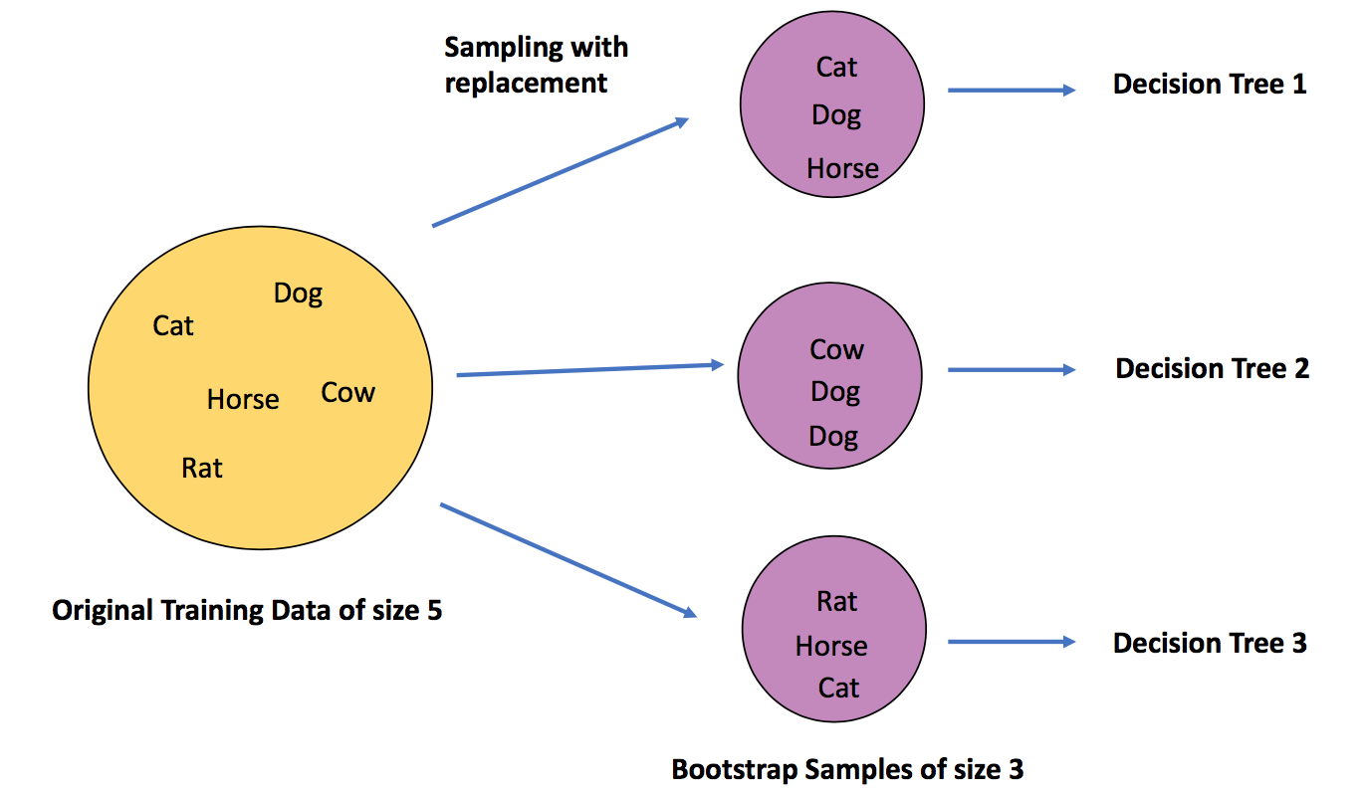
Random Forest Visualized
Source: https://towardsdatascience.com/what-is-out-of-bag-oob-score-in-random-forest-a7fa23d710

Slide 12
Additional Random Forest Hyperparameters
All Decision Tree hyperparameters are available for Random Forest, but there are additional choices specific to Random Forest as well.
Hyperparameters | What It Does | How It Helps
Number of Estimators | Number of trees in the forest | Increasing this value can decrease overfitting but may drastically increase training time
Bootstrap | Whether a subset of samples are used in creating the tree. If false, all samples are used. | Bootstrapping decreases bias and tends to decrease overfitting
Class Weight | Assign weights to specific classes. | Helpful if predicting one class is more important than predicting the other, if there is a large class imbalance, or if models are consistently not predicting well for one class.
Maximum Samples | Maximum number of samples used to train each decision tree (can be an integer or a proportion) | Looking for a balance with the optimal bias and reduction overfitting.
Source: https://scikit-learn.org/stable/modules/generated/sklearn.ensemble.RandomForestClassifier.html

Slide 13
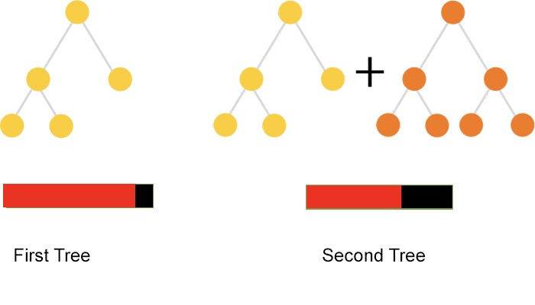
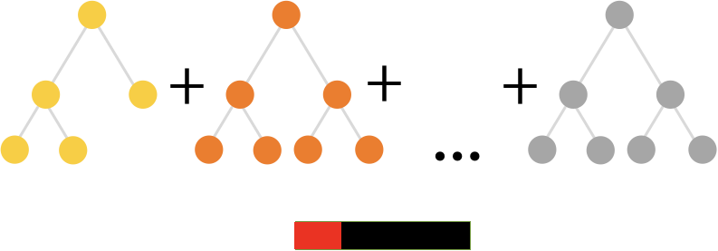
Gradient Boosted Regressor
We are starting with gradient boosted regressor because it is easiest to understand then we will build onto this for classification
Gradient boosting is similar to bagging in that it relies on the results from many decision trees
The goal is to make adjustments and learn from errors made in previous iterations of the model
Image Source: https://catboost.ai/news/catboost-enables-fast-gradient-boosting-on-decision-trees-using-gpus

Slide 14
Steps of Gradient Boosted Regressor
Find the mean value of the target value in the training data. This is our “base” prediction.
Calculate the residuals for each observation (i.e. the actual minus the predicted value)
Multiply the residual by a learning rate value forcing the algorithm to make small incremental changes over a larger number of decision trees
Construct a decision tree to predict the residual
  If there are multiple residuals in one leaf, find the mean residual for the entire leaf
Compute the new residuals
Repeat steps 3 through 5 until the number of decision trees equals the number specified in the hyperparameter number of estimators

Slide 15
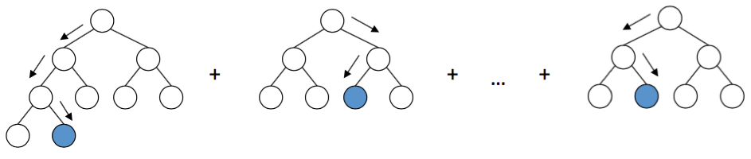
Gradient Boosted Regressor: Obtaining Prediction
The final prediction will be the mean calculated in step 1 plus the predicted residuals from all of the decision trees added together.
Base Value
Residual Decision Tree 1
Residual Decision Tree N

Slide 16
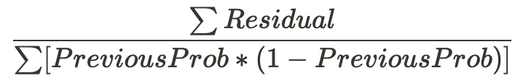
Gradient Boosted Classifier Modifications
Several adjustments have to be made to the modeling method to predict categories
To obtain the base value, you find the log odds of the target feature
  Equals the number of true values divided by number of false values
  This value is then converted to a probability using the logistic function
The residuals are then calculated for each instance in the training data set and multiplied by the learning rate
A new decision tree is used to predict this residual value
When there is more than one prediction in a leaf, use the following formula to get a single value:

Slide 17
Gradient Boosted Classifier: Making Predictions
To make new predictions the model uses the following formula for every decision trees created, adding the output together:
Then the logistic function is used to convert the prediction into a probability
Base Log Odds + (Learning Rate * Predicted Residual Value)

Slide 18
Additional Gradient Boosted Trees Hyperparameters
All Decision Tree hyperparameters are available for Gradient Boosted Trees, but there are additional choices specific to Gradient Boosted Trees as well.
Hyperparameters | What It Does | How It Helps
Number of Estimators | Number of trees to train to include in the prediction value. | Trade off between number of estimators and learning rate. Usually a larger number results in better performance but longer training/prediction times.
Learning Rate | Shrinks the contribution of each tree by this value. | Trade off between learning rate and the number of estimators.
Subsample | The fraction of samples used for fitting the number of base learners. Default is one. When < 1 this is called Stochastic Gradient Boosting. | Values less than 1 results in a reduction in variance and an increase in bias.
Loss Function | Choose loss function to optimize when splitting the data. | Various options available for classification and regression.
Tolerance | Tolerance for early stopping. If the loss is not improved by at least the tolerance for specified number of iterations no change, training stops. | Larger numbers will decrease overfitting.
Number of Iterations No Change | Used to decide if early stopping will be used to terminate training when validation score is not improving. | The larger the number, the more accurate the decision to stop early will be. However, it will take longer to train.
Validation Fraction | Proportion of training data used as a validation set for early stopping. | The larger the fraction, the more accurate the decision to stop early will be. However, it will take longer to train.
Source: https://scikit-learn.org/stable/modules/generated/sklearn.ensemble.GradientBoostingClassifier.html

