Slide 1

Intro to PySpark: Class 5
By Kelsey Emnett

Slide 2
Links
Files located here: bit.ly/intro-to-pyspark
Class videos will be posted by the Sunday after class on my website www.kelseyemnett.com and my YouTube channel https://www.youtube.com/channel/UCR7ejcDyKykQ3wE-KS08Smg.

Slide 3
Agenda
1 Installing MLFlow
2 Tracking Model Runs
3 Registering Models
4 Maintaining Models in Production

Slide 4
Class Machine Learning Example
Data:
Trying to Predict:
Goal:
Includes every admission to a substance abuse treatment center that is publicly funded by the government
Which admissions are ”first time admissions” and which were “repeat admissions”
To predict which individuals are at high risk for relapse upon admission to a substance abuse treatment facility
Treatment Episode Data Set Available Here
4

Slide 5

MLFlow Overview
MLFlow is an open source package created by Databricks
It allows you to track and version your models as you tune them
  Can log model hyperparameters and evaluation metrics
  Can then reproduce a model run to achieve an identical result
Can retrieve logged runs in an easy-to-use UI
It also allows for model registration and easy deployment
https://mlflow.org/
Source: Spark The Definitive Guide, Chambers & Zaharia

Slide 6
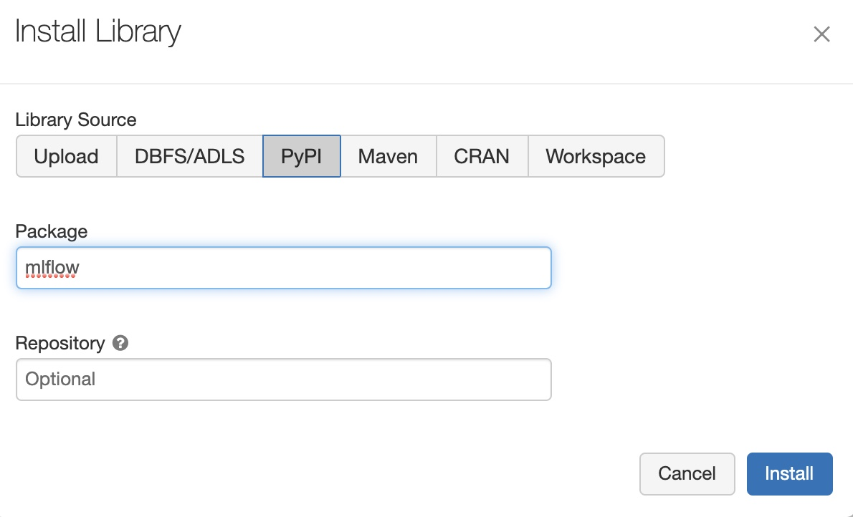
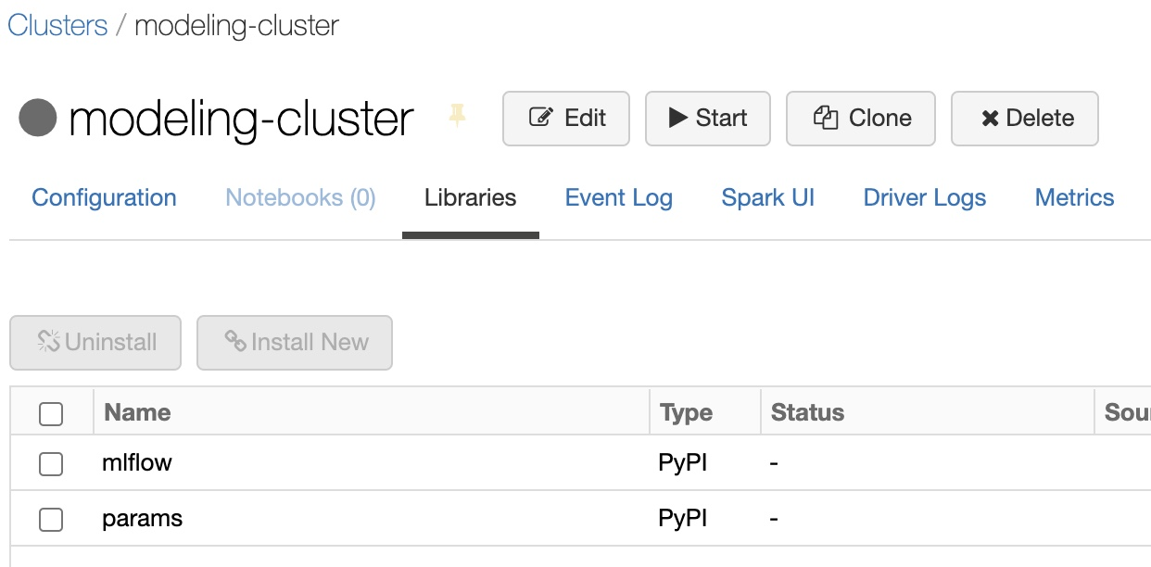
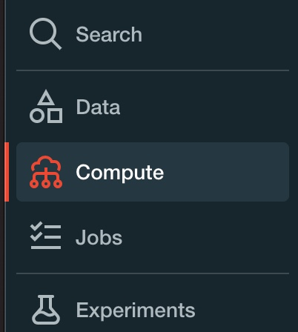
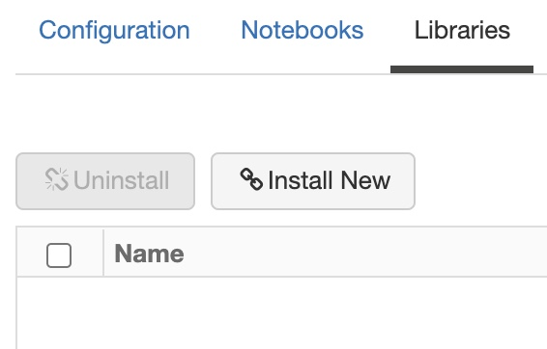
Install MLFlow
Go to your compute cluster by clicking compute in the left-hand menu
Go do your active cluster
Click Libraries in the top menu
Click Install New
Click on PyPi and put mlflow in the Package box
Click Install

Slide 7
Logging Metrics
with mlflow.start_run(run_name="run_name") as run:
mlflow.log_param("parameter_name", 1)
mlflow.set_tag('tag_name', 'tag_value')
mlflow.spark.log_model(model_object, ”model_name")
mlflow.log_metric("metric_name", 0.83)
csv_path = "./file_name.csv"
coefficient_df.to_csv(csv_path, index=False)
mlflow.log_artifact(csv_path)
Start Run
Log model hyperparameter
Log tag
Log model
Log model metric
Log artifact

Slide 8
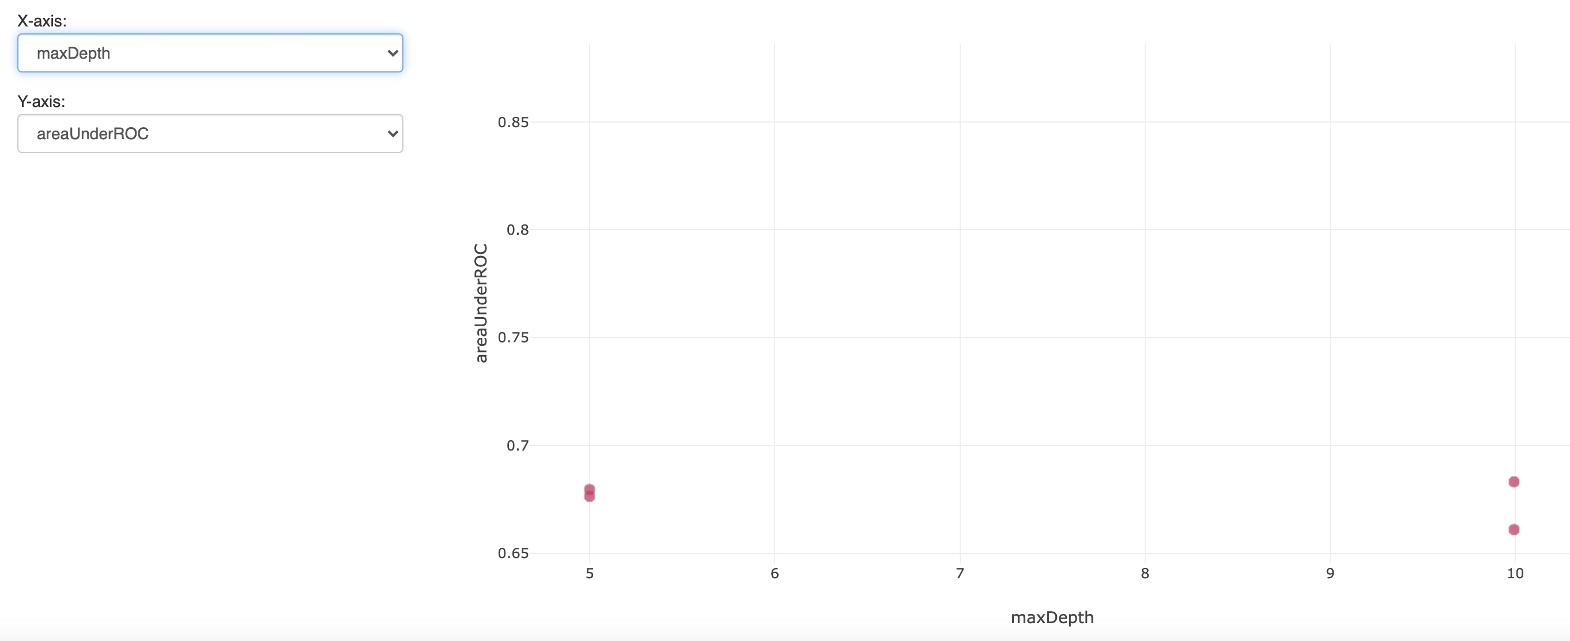
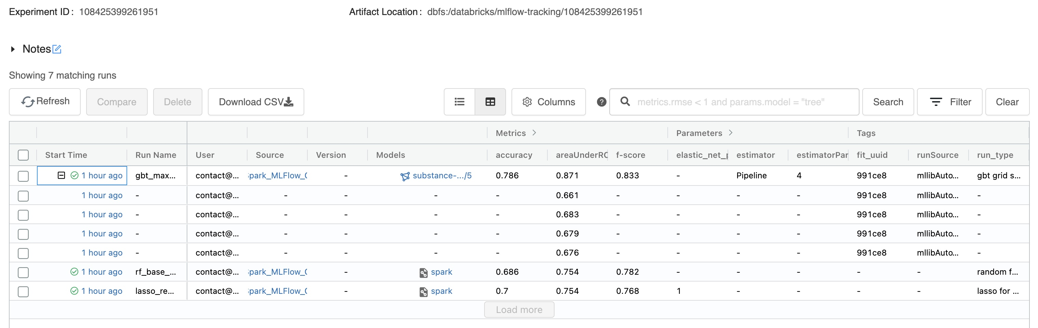
MLFlow UI
Tracks all logged logged metrics and parameters
Can compare models using visualizations

Slide 9
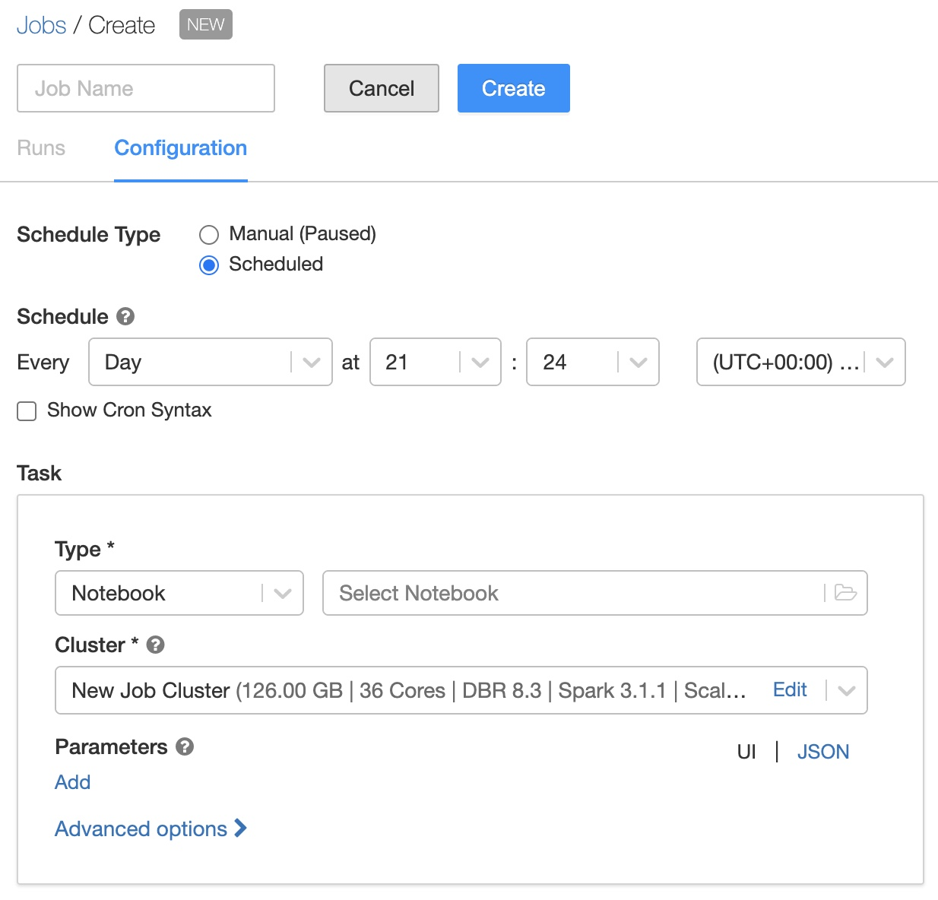
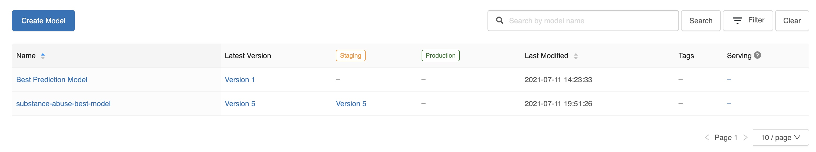
Model Registry
MLFlow allows for easy scheduling of model runs
Can register model versions in a model registry
  Allows for tracking model changes
  Can easily load most recent model to use to calculate predictions
Notebooks can then be scheduled or triggered to run, including:
  Spinning up a cluster
  Running scheduled notebook
  Depositing results in storage
  Spinning down the cluster once complete

Slide 10
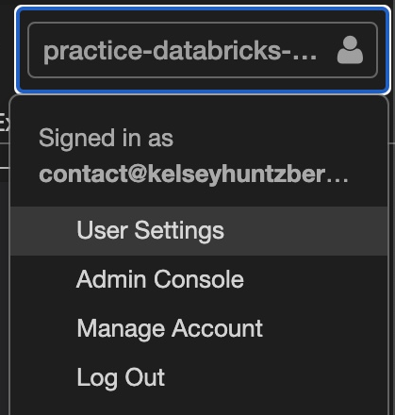
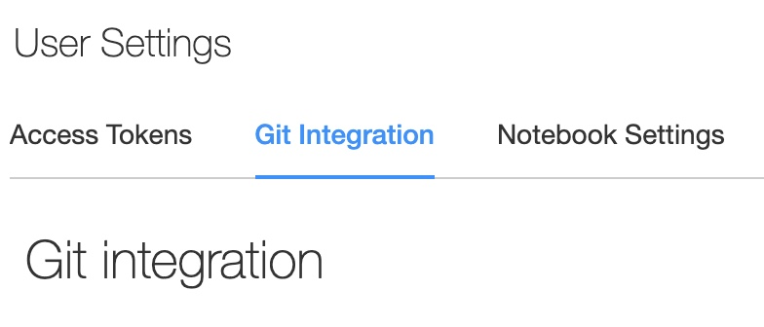
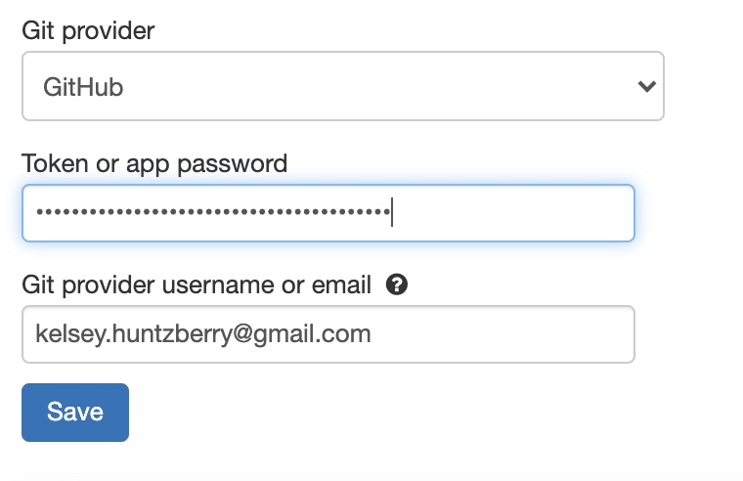
Connecting to Github: Adding Token
Create a personal access token on Github
  If you need instructions visit this link
Go to User Settings by:
  Clicking on the workspace name in the upper right-hand corner
  Clicking User Settings
Click on Git Integration in the top menu
Choose your Git provider (in this case Github)
Copy your personal access token from Github into the space
Provide your email address from your Github account

Slide 11
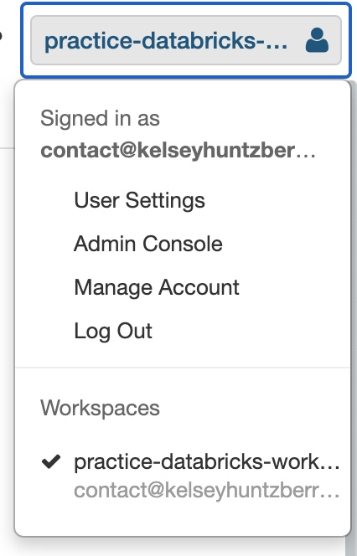
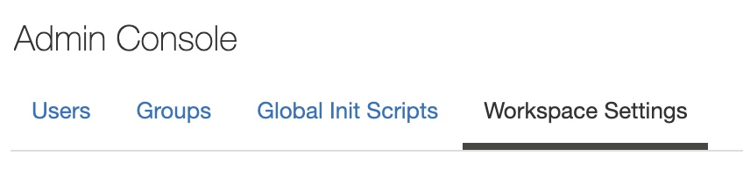
Connecting to Github: Enable Databricks Repos
In Databricks, click on your workspace name again in the upper right-hand corner
Click Admin Console
In the top menu go to Workspace Settings
Make sure Repos is listed as Enabled
  If it is not, click the button on the right and click so it is blue as shown here

Slide 12
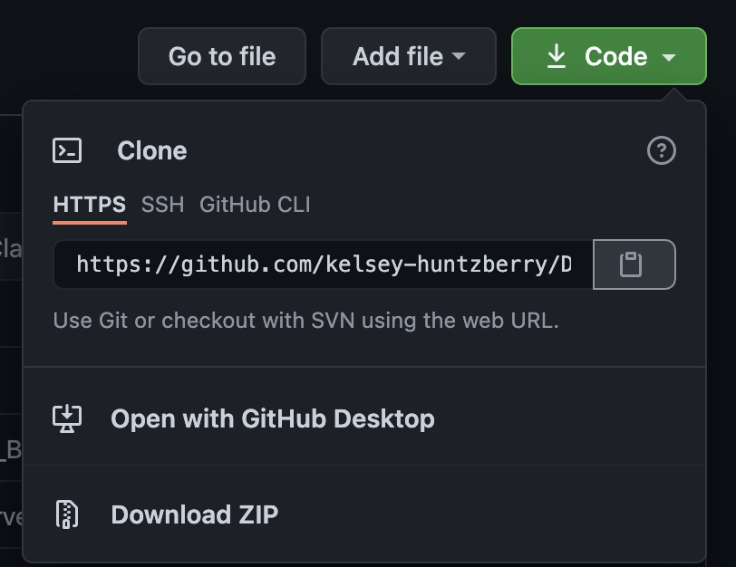
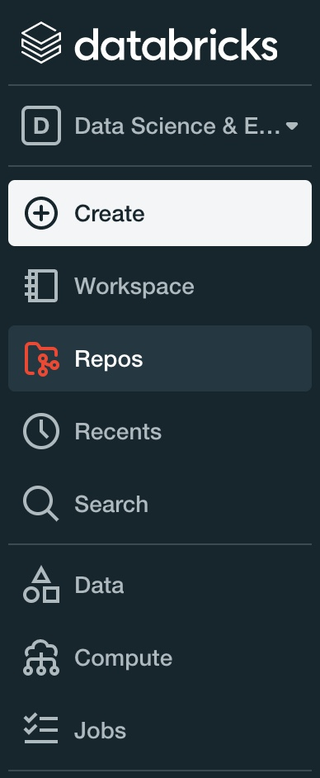
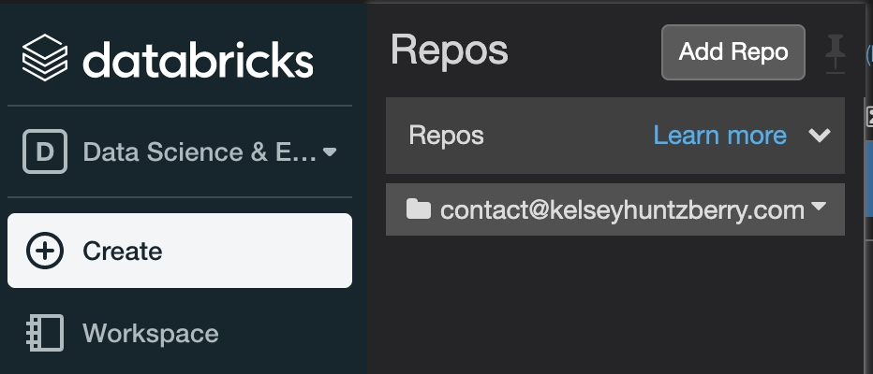
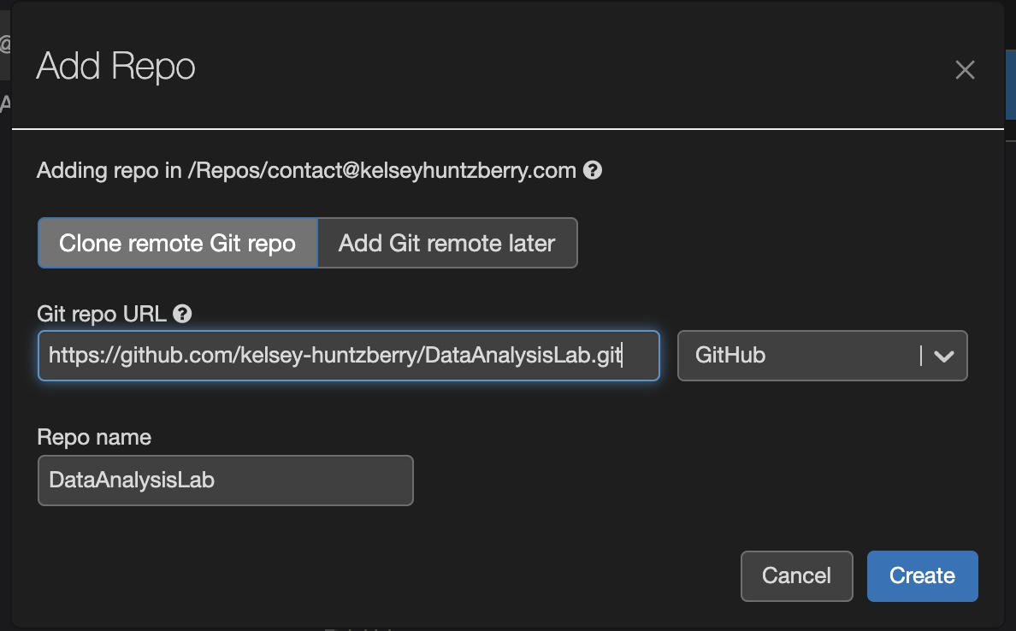
Connecting to Github: Making the Connection
Click on the Green Code button on your Github repository that you want to sync with Databricks
Go back into Databricks. In the menu on the left Click Repos
Click Add Repo
Put the URL you copied into the “Git repo URL” box
Everything else should autofill!

Slide 13
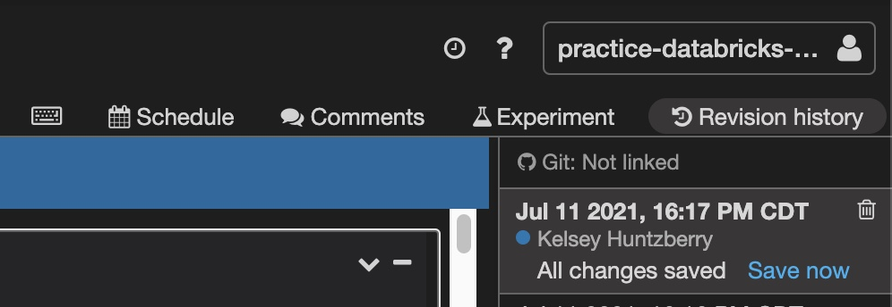
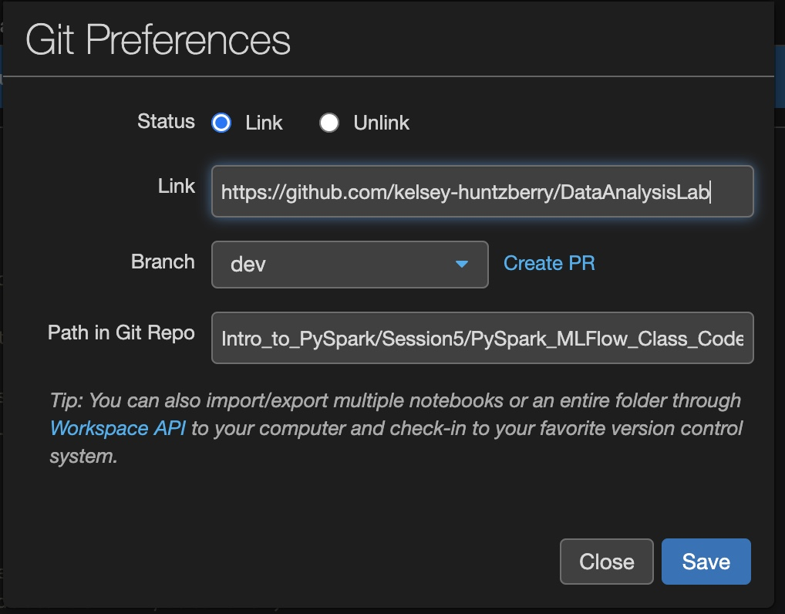
Connecting to Github: Adding Notebook to Repo
Go into the notebook you want to connect to Github
Click on Revision history in the upper right-hand corner
Click “Git: Not linked”
Click “Link” button next to Status
If Link does not autofill, paste the same link you copied from your Github here
Choose Branch (create new if it doesn’t show up)
Change the folder path to match where you want your code to go in Github

