Slide 1

Machine Learning for Beginners: Class 4
By Kelsey Emnett

Slide 2
Links
Files located here: bit.ly/machine-learning-introduction
Class videos will be posted by the Sunday after class on my website www.kelseyemnett.com and my YouTube channel https://www.youtube.com/channel/UCR7ejcDyKykQ3wE-KS08Smg.

Slide 3
Class Machine Learning Example
Data:
Trying to Predict:
Goal:
Includes every admission to a substance abuse treatment center that is publicly funded by the government
Which admissions are ”first time admissions” and which were “repeat admissions”
To predict which individuals are at high risk for relapse upon admission to a substance abuse treatment facility
Treatment Episode Data Set Available Here
3

Slide 4
Linear Regression Overview

Slide 5
Linear Regression Review
Predicts a continuous/numeric value
Takes the weighted average of the input features and adds a constant called the y-intercept
  ŷ is the value we are predicting.
  n is the number of features of our data points.
  x_{i} is the value of the ith feature.
  Θ_{i} are the parameters of the model, where Θ₀ is the y-intercept. All the other parameters are the weights for the features of our data.
Example: Predicting House Price
Source: https://towardsdatascience.com/linear-regression-explained-d0a1068accb9
Source: https://towardsdatascience.com/linear-regression-explained-d0a1068accb9

Slide 6
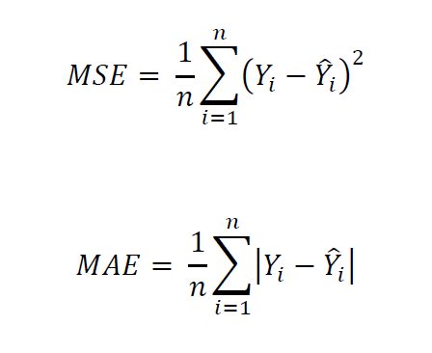
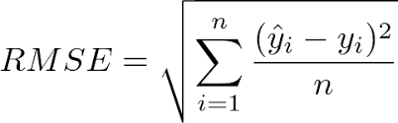
Linear Regression Steps: Cost Functions
Cost Functions
Root Mean Squared Error (RMSE) is a common choice (shown below)
Mean Absolute Error (MAE) is another common choice
RMSE more heavily penalizes outliers
Source: https://towardsdatascience.com/linear-regression-explained-d0a1068accb9
Source: https://towardsdatascience.com/linear-regression-explained-d0a1068accb9

Slide 7
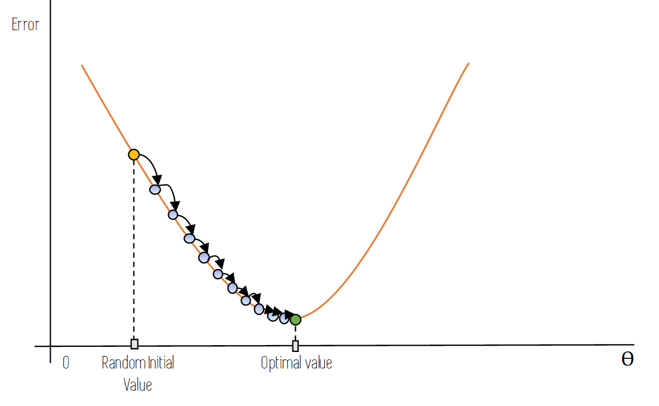
Linear Regression Steps: Gradient Descent
Randomly initialize Θ_{i}
Make a prediction for every training data point
Compare predicted and actual value using the cost function
Calculate the derivative or the line tangent to the loss function
Use sign of derivative to move up (positive derivative) or down (negative derivative) the cost function a small amount
Modify model parameters
Repeat until the bottom of the curve or the ideal point is reached
Source: https://towardsdatascience.com/linear-regression-explained-d0a1068accb9
Source: https://towardsdatascience.com/linear-regression-explained-d0a1068accb9

Slide 8
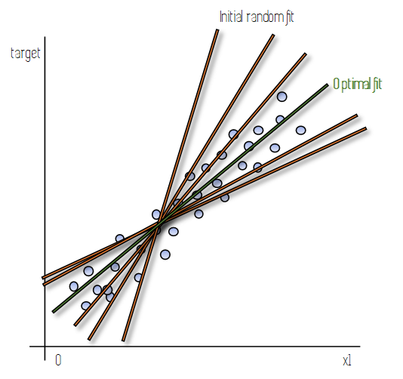
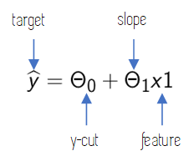
Linear Regression Steps: Model Function
Iterative adjustment of model parameters tested many models
Gradient descent ends with a function with ideal model parameters
Leaves you with a final function for the linear regression line as shown below:
Source: https://towardsdatascience.com/linear-regression-explained-d0a1068accb9
Source: https://towardsdatascience.com/linear-regression-explained-d0a1068accb9

Slide 9
Logistic Regression Overview

Slide 10
Logistic Regression Overview
Used to predict a class or category
Binary classification: Model predicting binary target with 2 features
Multinomial classification: Model predicting target with 3+ features
Returns a probability between 0 and 1
Most commonly, 0.5 is the cut off for a positive or negative prediction
  Greater than or equal to 0.5 = positive prediction
  Less than 0.5 = negative prediction
This cut off can be adjusted as needed in any classification model (think ROC AUC curve from last week)
Source: https://towardsdatascience.com/logistic-regression-explained-9ee73cede081

Slide 11

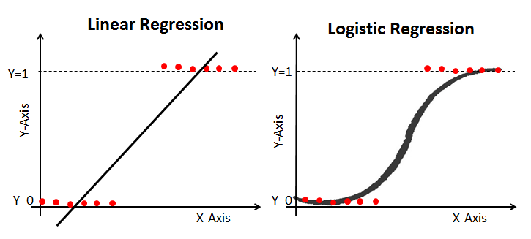
Linear vs. Logistic Regression
Linear regression fits a straight line to your data
Logistic regression fits data to an s-shaped curve called the sigmoid function
Added step after finding the weighted sum of input features like we just saw for linear regression
Fits prediction between 0 and 1
Find weighted sum of inputs
Find the probability of obesity with the sigmoid function
Source: https://towardsdatascience.com/logistic-regression-explained-9ee73cede081

Slide 12
Regularization

Slide 13
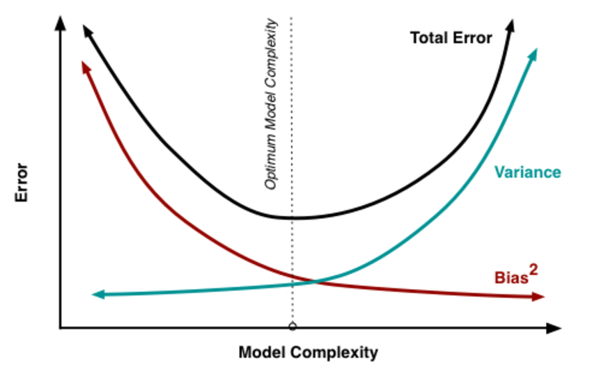
Regularized Regression
Linear and logistic regression have a number of assumptions that have to be met to use them in practice
We will not be covering these in class but some slides for linear regression are in the Appendix
When using too many features in both models, this can lead to overfitting and breaking of these assumptions
A great way to prevent that is regularization with:
  Lasso regression
  Ridge regression
  Elastic net regression
Source: Datacamp Link

Slide 14
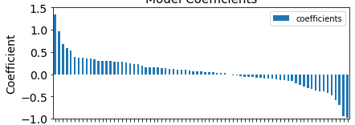
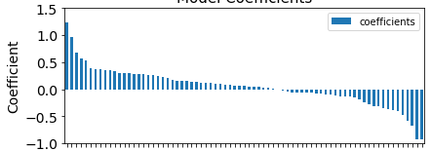
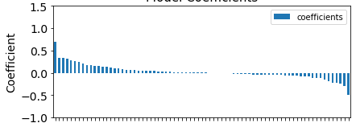
Ridge (L2) Regression Overview
Ridge regression adds a penalty term that penalizes the size of coefficients
Reduces the coefficients towards zero, but never all the way to zero
Decreases bias and overfitting
Adjusted using regularization parameter, often called C
Sizes of C:
  1 is normal linear regression
  Lower values increase penalty on coefficients
C = 1
C = 0.2
C = 0.001
14

Slide 15
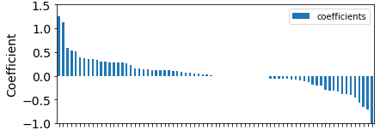
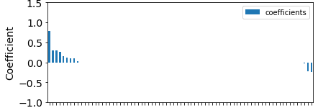
Lasso (L1) Regression Overview
Lasso regression also adds a penalty term that penalizes the size of coefficients
Reduces the coefficients to zero. Less important features will equal zero.
Like Ridge Regression decreases bias and overfitting
C parameter works the same as with Ridge Regression
C = 1
C = 0.2
C = 0.001
15

Slide 16
Lasso vs. Ridge Regression: Which Is Better?
Both address overfitting
Handling of multicollinearity:
  With Ridge Regression, coefficients of correlated features will be similar
  With Lasso Regression, will keep the correlated feature with the higher coefficient and nearly zero out the lower coefficient
Lasso will be better when there a few important features
Ridge is better when there are many features that have importance
16

Slide 17
Lasso vs. Ridge Regression: Which Is Better?
In general, more information is lost when using Lasso versus Ridge regression because unimportant features are completely removed
Lasso is better for performing feature selection
Elastic Net Regression is an option available that is a compromise between Lasso and Ridge Regression
17

Slide 18
Appendix

Slide 19
Assumptions: Check for Outliers
This code produces a graph showing influential data points
Any extreme data points like 1758 should be removed
Extreme outliers will bias the model leading to faulty assumptions
Notes:
Give Github link on slidesou

Slide 20
Assumptions: Normally Distributed Errors
Can check for a normal distribution graphically
Values should fall into an approximate straight line on the Q-Q plot
This graph demonstrates normal distribution
Notes:
Give Github link on slidesou

Slide 21
Assumptions: Homoskedasticity
Variances have to be equal or homogenous
Check with residual plots
Red lines should be flat and the dispersion around the x-axis should be relatively equal
Notes:
Give Github link on slidesou

Slide 22
Assumptions: Linearity
Linear regression can only be used on linear data
If the data has quadratic or logarithmic patterns it will give biased results
If dashed line is similar to blue dashed line, that means our data is linear
Notes:
Give Github link on slidesou

