Slide 1

Machine Learning for Beginners: Class 2
By Kelsey Emnett

Slide 2
Links
Files located here: bit.ly/machine-learning-introduction
Class videos will be posted by the Sunday after class on my website www.kelseyemnett.com and my YouTube channel https://www.youtube.com/channel/UCR7ejcDyKykQ3wE-KS08Smg.

Slide 3
Types of Models
Classification
  Predicting a categorical variable using known class labels
  Example: Predicting whether a substance abuse treatment admission is the first or readmission
Regression
  Predicting a continuous or numeric variable using known actual values
  Example: Predicting crop yield
Unsupervised
  Models that detect patterns and make predictions on data with no pre-existing labels
  Example: Clustering stores by similar attributes
Reinforcement Learning
  Enables an agent to learn in an interactive environment by trial and error using feedback from its own actions and experiences¹
  Example: Stock trading where model buys, sells, or trades and adjusts predictions based on results of trade

Slide 4
Classification or Regression?
Are you trying to predict a continuous variable?
  Does it highly unbalanced and/or have a large number of outliers
  If so, it may be difficult to predict values accurately
Often data scientists turn regression models to classification models
  Great if there is a meaningful cut off
  Example: Considering business investments and the business considers any venture making $300,000+ to be a “success”
  Can predict high revenue ($300,000+) or low revenue (less than $300,000) business investments

Slide 5
Examples from the Field
Predicting success in seed production process
Predicting high and low-value revenue business opportunities
Extracting text from images
Predicting individuals at high risk of relapse from a substance abuse disorder (the example used in this class)
5

Slide 6
Class Machine Learning Example
Data:
Trying to Predict:
Goal:
Includes every admission to a substance abuse treatment center that is publicly funded by the government
Which admissions are ”first time admissions” and which were “repeat admissions”
To predict which individuals are at high risk for relapse upon admission to a substance abuse treatment facility
Treatment Episode Data Set Available Here
6

Slide 7
Detour: The Normal Distribution
The normal distribution is also called a bell curve
It is important because it is required to perform many basic statistics tests
It is symmetrical
The mean, median, and mode all lie near the center
No long outlier tails on one side
Image Source: https://www.mathsisfun.com/data/standard-normal-distribution.html
Notes:
Give Github link on slidesou

Slide 8
Detour: The Normal Distribution
Normal distributions can differ in their means and standard deviation
They are always more dense in the center and less dense at the tails
Notes:
Give Github link on slidesou

Slide 9
The Normal Distribution: Characteristics
Area under the curve is equal to 1
68% of the area is within 1 standard deviation of the mean
95% of the area is within 2 standard deviations of the mean
99% of the area is within 3 standard deviations of the mean
Image Credit: https://towardsdatascience.com/understanding-the-68-95-99-7-rule-for-a-normal-distribution-b7b7cbf760c2
Notes:
Give Github link on slidesou

Slide 10


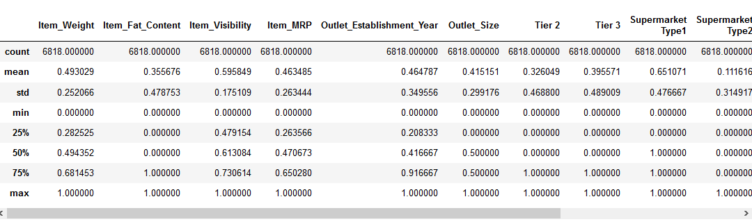
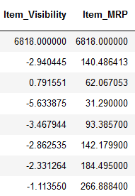
Data Pre-Processing: Continuous Variables
Machine learning models often use distance calculations and loss functions to generate predictions
Features with a larger range will have larger weight unless rescaled
Standardize or normalize continuous variables, i.e. scale them to the same range
Normalization: Rescale variables to range between 0 and 1
Standardization: Rescale variables to be centered around the mean with each unit increase/decrease as one standard deviation (think z-scores)
Normalization
Standardization
µ: mean
σ: standard deviation
Not Normalized
Normalized
https://www.analyticsvidhya.com/blog/2020/04/feature-scaling-machine-learning-normalization-standardization/

Slide 11
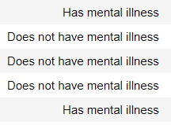
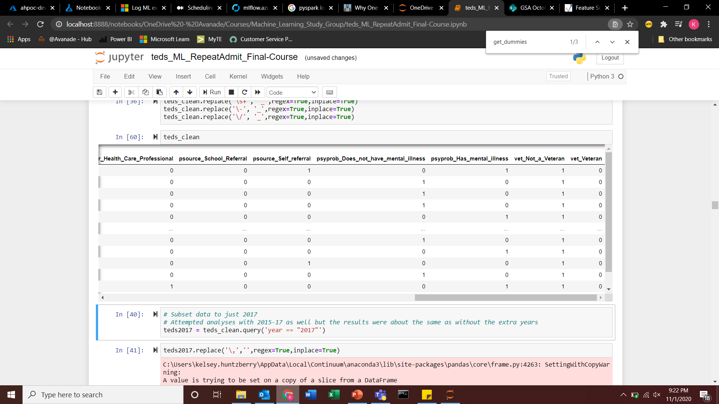
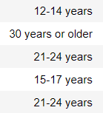
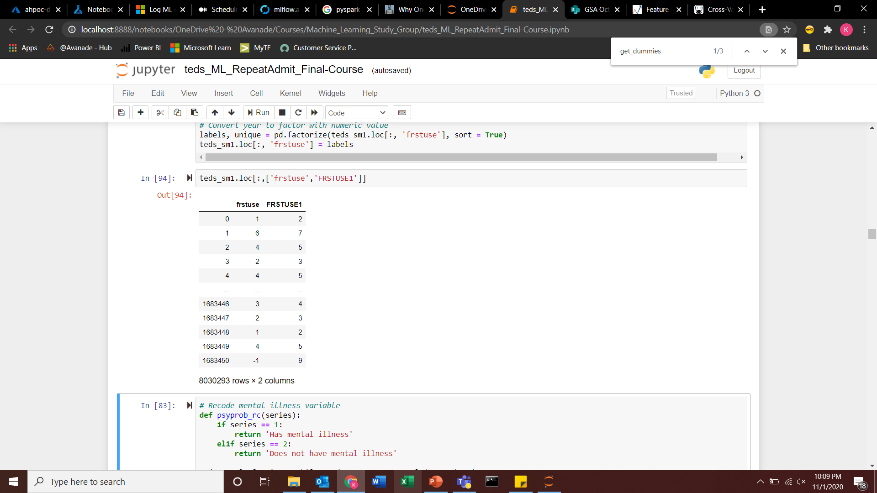
Data Pre-Processing: Categorical Variables
Original
Pre-Processed
Has Mental Illness
Does Not Have Mental Illness
Machine learning requires features to be numeric, not categorical
Categorical variables are converted to numeric variables
Use One-Hot Encoding or Integer Encoding to create numeric variables
Mental Illness
Unordered Feature: One-Hot Encoding
Age of First Use
Age of First Use
Ordered Feature

Slide 12
Handling Missing Values
Most commonly people fill in missing values with mean or mode
More complicated methods exist, but most commonly they do not perform better than simple imputation when using machine learning
  Using KNN imputation, MICE algorithm are examples
Can also make “missing” its own category if you think a missing values hold value for your model

Slide 13
Data Set Up in Python
All data must be in numpy arrays in numeric form
Response is in a different array than model features
Any missing values will be complete removed from your model when it’s run

Slide 14
Model Validation Process
Use a section of your data as training data to build the model
Often train multiple types of models with different hyperparamaters
Hyperparameters: Model inputs set by the modeler that you optimize by tuning and testing the accuracy of multiple models
Test different models on another section of your data the validation data set
A final accuracy test is typically done on data unseen during training once a model is chosen called a holdout data set

Slide 15
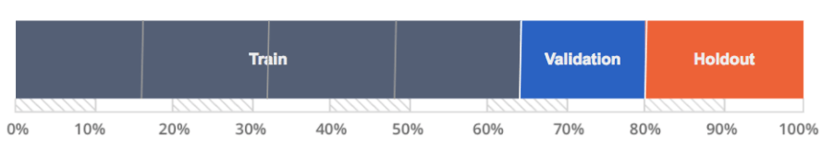
Model Validation: Train-Test Shuffle Split
To improve and validate machine learning models, a common method is to split the data into train, validation, and holdout data sets
Models are built using training data and the best model is chosen based on the accuracy of prediction with the validation data set
Once a model is chosen, you use the holdout or test data set to do a final test of accuracy for your model on unseen data
  Data unseen during training gives a less biased accuracy estimate
15
Source: https://www.datarobot.com/wiki/cross-validation/

Slide 16
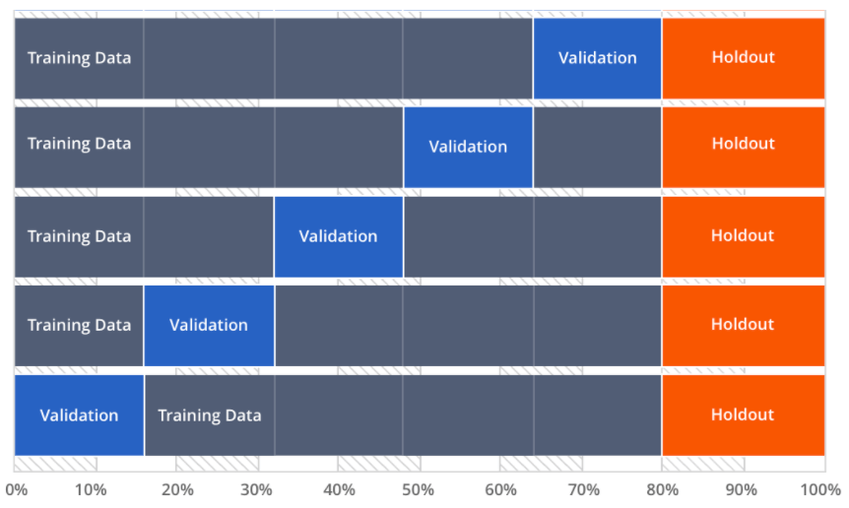
Model Set Up: K-Fold Cross Validation
Splits data into the number of data specified by the user
In example on right, 5 iterations (k) of a model are trained
The model is trained using the gray sections and tested it on the blue sections
Accuracy metrics are averaged across training runs to measure model performance
Similar to shuffle split, the holdout is used for a final test of accuracy
16
Source: https://www.datarobot.com/wiki/cross-validation/

Slide 17
K-Fold Cross Validation: Choosing K
Empirical evidence show a k of 10 is ideal
With large data sets, you can use 5
If you are using a small data set increase the number of k
  Allows more data to be used in each iteration for training
  Decreases bias when calculating average accuracy
k = 5
17
Source: https://www.datarobot.com/wiki/cross-validation/

Slide 18
Stratification: Do You Need It?
Do you have a classification problem that has one category with a larger proportion of data in it than the other category?
This means you have unbalanced data
If so, you should stratify your data during validation
  Make sure proportion of data in each class stays constant when data is randomly split during model validation
18

Slide 19
Other Methods for Small Sample Sizes
Bootstrapping
  Creates groups for model validation through repeated resampling with replacement
  Should only be used for small sample sizes
  Can be used if there is large class imbalance in your target variable by oversampling the smaller target group
  Biased towards worse accuracy
Leave-One-Out Cross Validation (LOOCV)
  Set number of folds equal to the number of training examples
  Only one value is used is used for testing with all others used for training
  Recommended method for very small data sets
19

Slide 20
Comparing Model Validation Methods
Validation Method | Pros | Cons
Train-Test Shuffle Split | Faster on large data sets | Large section of data not used for training
K-Fold Cross Validation | All data points used for training Most accurate method | Processing intensive, especially on large data sets
Bootstrapping | Good for small data sets | Biased towards worse accuracy
Leave-One-Out Cross Validation | Good for extremely small data sets | Very processing intensive
20
Source: https://www.datarobot.com/wiki/cross-validation/

Slide 21
Appendix

Slide 22
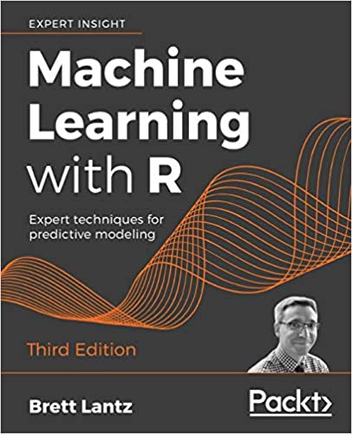
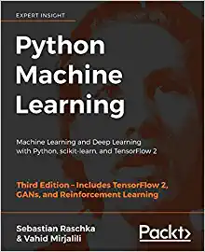
Learning Resources
My website has a list of reference links for specific models and machine learning concept
Recommended books:
  Machine Learning with R (best for beginners)
  Python Machine Learning (best as a second read)
22

Slide 23
Open Data Sources
Data Source | Topic | Data Source | Topic
Census Data | Demographics | NCSL | State legislature policies
TEDS Data | Substance abuse admissions | NHIS, NSCH | Health survey data
NSDUH | Drug use prevalence | National Survey of Family Growth | Pregnancy, contraception
CDC Wonder | Mortality, cause of death | NOAA | Ocean, environment data
CDC Opioid Data | Prescribing rates, overdoses | BLS | Employment, labor statistics
MEPS | Medical expenditures | Twitter | Social media, tweets
SEER | Cancer outcomes, staging | NCDC | Weather data
SAHIE | Health insurance estimates | Kaggle | General
Gapminder | Country-level metrics | UCI Machine Learning Repository | General
World Bank | Country-level metrics
UCLA World Policy Analysis Center | International law/policies
23

