Slide 1
Introduction to PySpark
By Kelsey Emnett

Slide 2
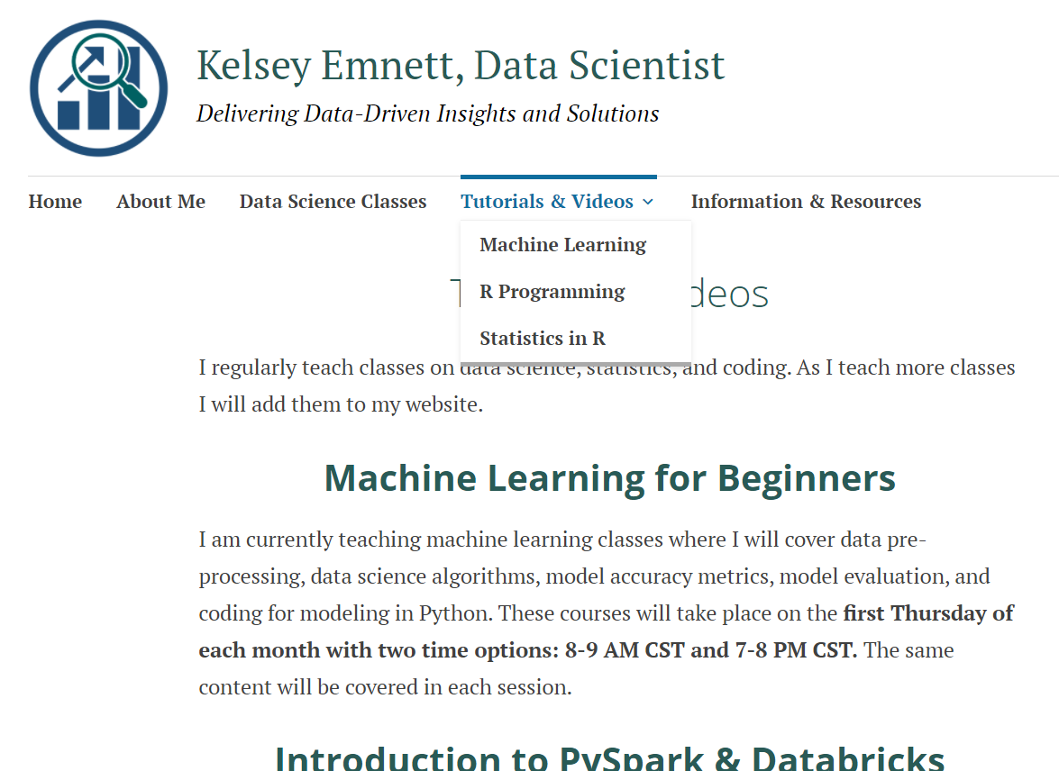
Class Files and Recordings
Class files (code, slides, data) can be found here: bit.ly/intro-to-pyspark
Usually by Sunday after each class, recordings will be posted on my YouTube channel first, then on my website
  YouTube Channel: https://www.youtube.com/channel/UCR7ejcDyKykQ3wE-KS08Smg
  Personal Website: www.kelseyemnett.com

Slide 3


Who Am I?
I am Kelsey Emnett, a senior consultant data scientist here at Avanade
I have 5 years of experience in statistical analysis and data science
Mostly focus on machine learning, Azure cloud services, and big data analytics
Fun fact! I just got married and built/moved into a new house!

Slide 4
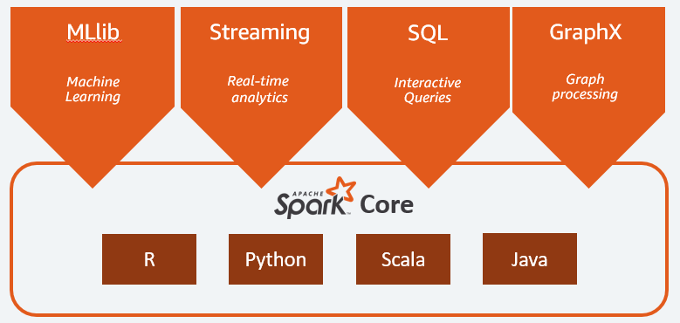
What is Spark? Why Use It?
Spark enables big data processing through parallel processing
Have choice of multiple languages to run Spark applications
We will be conducting this class in PySpark or “Python Spark”
PySpark operates on distributed Spark DataFrames
Source: https://aws.amazon.com/big-data/what-is-spark/

Slide 5

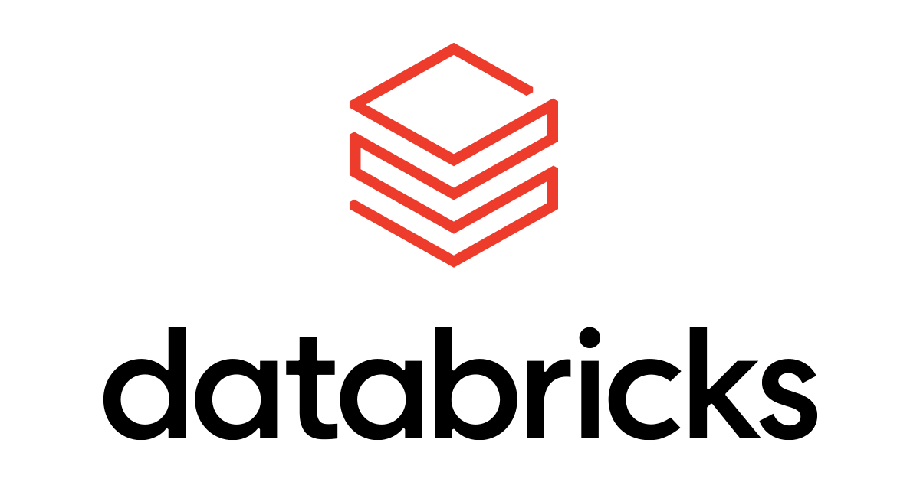
What Will We Be Covering?
Basic data transformations
DataFrame joins and aggregations
Optimizing Spark code
Koalas, or using Pandas for distributed processing
Working with Delta Lake
Modeling with MLlib
Model deployment and monitoring with MLFlow

Slide 6
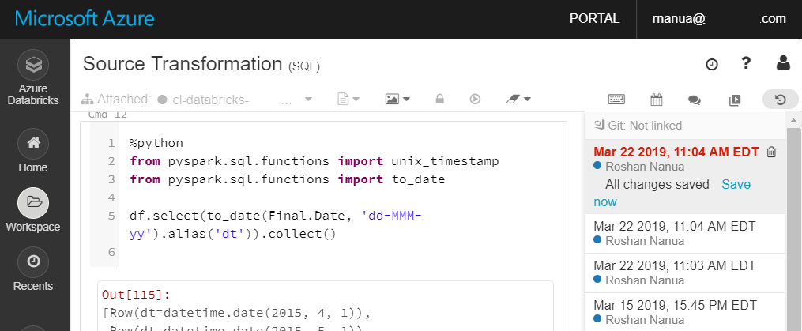
What is Databricks?
Databricks is the platform we will be running PySpark in this class
There are many choices for running Spark languages:
  Locally (this is free!)
  AWS EMR
  Azure HDInsight
Databricks Features:
  Easy to use
  Very little set up
  Koalas, used parallelizing Python Pandas code
  Delta Lake
  MLFlow
  Changing Spark languages in the same notebook

Slide 7
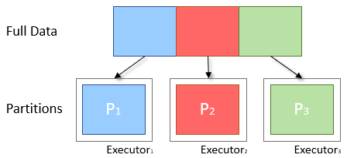
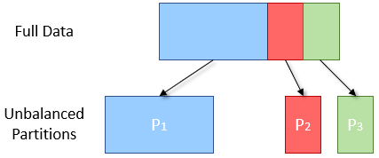
Data Partitioning
Ideal
Spark breaks data into chunks, or a group of rows
Parallelism: Groups of data on multiple cluster nodes simultaneously
Processing data in smaller chunks allows you to process larger data sets more quickly
Can scale from 1 to thousands of executors based on data size
Reality
Source: https://blog.scottlogic.com/2018/03/22/apache-spark-performance.html

Slide 8
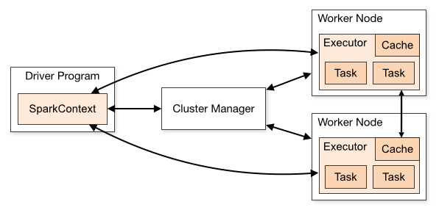
Spark Architecture
Spark Driver
  Converts user applications to smaller execution “tasks”
  Schedules tasks on clusters
Cluster Manager
  Manages and allocates resources to cluster nodes
Worker Nodes
  Runs application code in the cluster
Spark Executor
  Executes tasks on each worker node
  Communicates with the driver program
  Keeps data in memory or disk storage
Task
  A unit of work sent to one executor
Source: https://spark.apache.org/docs/latest/cluster-overview.html#cluster-manager-types

Slide 9
Transformations vs. Actions
Transformations
Actions
Changes a Spark DataFrame into a new DataFrame without altering the original data (i.e. immutable)
Evaluated lazily or not computed immediately
Adds a step into the Spark query plan
Examples: select(), filter()
Triggers a computation
Causes Spark to execute a query plan (a series of transformations)
Returns a result
Example: count(), display()

Slide 10
Lazy Evaluation
As mentioned, Spark has “lazy” or delayed execution
Spark inspects query and optimizes them by:
  Generates multiple plans and chooses the best one with a cost model
  Reorders transformations
  Breaking them into stages
  Optimizes “shuffles” where data is “shuffled” between workers

Slide 11
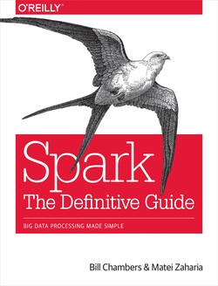
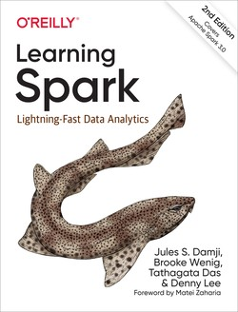
Recommended Resources
Learn by doing! Choose a project and do it. Then come present what you did in class!
Learning Spark by Damji, Wenig, Das, and Lee
Spark The Definitive Guide by Chambers and Zaharia
The two books above are excellent for preparing for the Databricks Certified Associate Developer for Apache Spark 3.0 and the Databricks Certified Associate ML Practitioner for Apache Spark 2.4
Databricks Ebooks: https://databricks.com/resources
Link
Link

