Slide 1
Introduction to R
Indexing vectors and data frames
By Kelsey Huntzberry, MPH

Slide 2
Indexing with Vectors & Data Frames

Slide 3
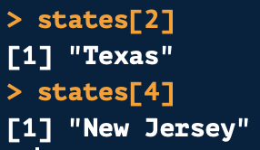
Indexing Using Position with Vectors
Each position on a vector has a numeric position
Indexing uses a value’s numeric position or value to subset a vector or data frame
Python Users: Indexing starts at 1 in R!
Example using vector above:
Positions
1
2
3
4

Slide 4
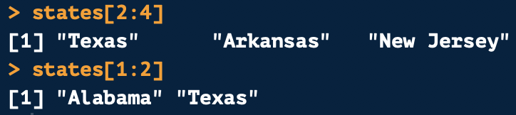
Indexing Using Position with Vectors
You can also reference a range of consecutive values with indexing using a :
Example using vector above:
Positions
1
2
3
4

Slide 5
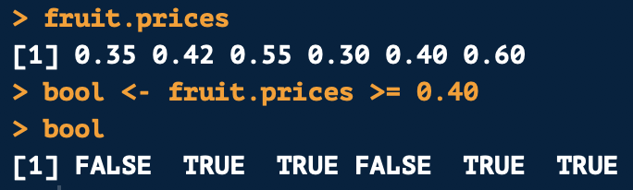
Subetting Vector Based on Value
You can also subset a vector based on its value
For example, we can pull all values greater than or equal to 0.40 in fruit.prices
First create a logical vector for fruit.prices
This will return a logical vector (i.e. TRUE/FALSE)

Slide 6

Subetting Vector Based on Value
A logical vector is stored in 1s and 0s
  TRUE is stored as 1 with a length of 1
  FALSE is stored 0 with a length of 0
When indexing:
  If there is a 1, the value is returned
  If there is a 0, the value is dropped
Example:

Slide 7
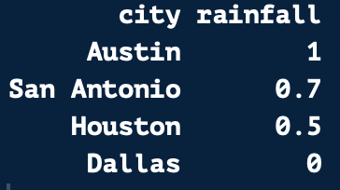
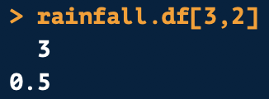
Indexing Using Position with Data Frames
Indexing works similarly on a data frame
The first number is the row position
The second number is the column position
1
2
1
2
3
4
Row 3
Column 2
Returns:
Positions

Slide 8

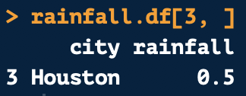
Pulling Full Rows and Columns from a Data Frame
1
2
To pull a full column, leave the row number blank
To pull a full row, leave the column number blank
Always leave the comma in!
1
2nd Column
2
3
4
Positions
3rd Row

Slide 9
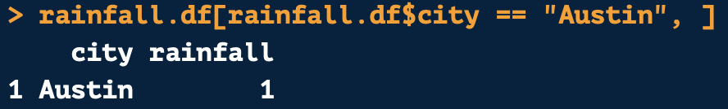
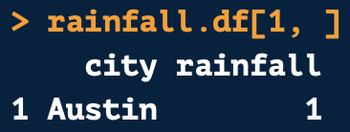
Indexing Based on Row Values
1
2
You can also index based on row values
1
2
3
Equivalent
4
Positions

Slide 10
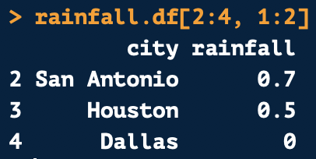
Indexing Multiple Values from a Data Frame
Like on vectors, you can pull multiple consecutive values
1
2
1
2
Row 2, 3, & 4
Column 1 & 2
3
4
Positions
Returns:

Slide 11
Indexing Lists

Slide 12
Simple Lists
Create a list with the list() function
Remember:
  Lists can have multiple data types
  Lists can be nested, meaning one list can be placed inside another list

Slide 13
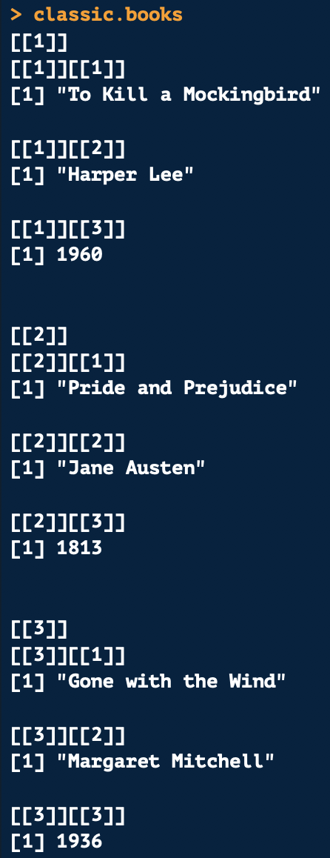
Nested Lists
Below shows how to create a nested list (a list within a list):

Slide 14
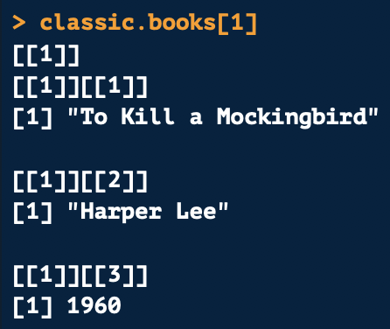
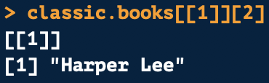
Indexing Nested Lists
To refer to the entire first list within the main list use single brackets
To access a single value within a single list use double brackets for the list number and single brackets for the value

Slide 15
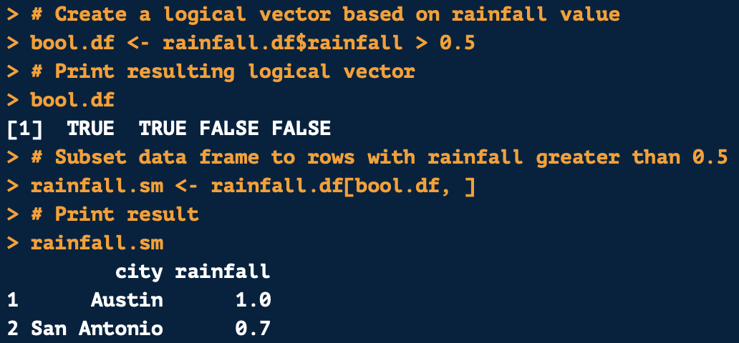
Subsetting a Data Frame Based on Value
Like with vectors, you can subset a data frame based on its values using indexing
First create index using value a rule applying to your desired variable
  In this case, pulling rainfall values greater than 0.5
This will produce a logical vector where it is TRUE if a value is greater than 0.5 and FALSE if less than or equal to 0.5

Slide 16
Subsetting a Data Frame Based on Value
To pull all rows with rainfall greater than 0.5, put the logical vector in the row position
  Because we want to pull data based on row
Keep column position blank since we want all columns for rows meeting the criteria
This will return all rows with rainfall greater than 0.5

Slide 17
Missing Values

Slide 18
Types of Missing Values
NA or “not available”
  Missing value
  Length of 1
NaN is “not a number”
  Returned if finding the square root of a negative number
NULL or “null object”
  Will be returned from a function where a value is undefined
  Empty value with zero length
Infinite
  Will be returned if you divide by zero

Slide 19
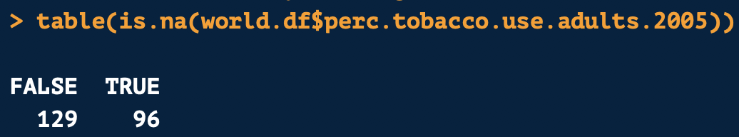
Identifying Missing Values
Can check missing value type by using is.na(), is.null(), or is.nan(), or is.infinite()
This will return a logical vector telling you whether a value is missing (TRUE) or not (FALSE)
Can use is.na() inside the table() function to find out how many missing values are in a column

Slide 20
Replacing Values and Changing Column Names

Slide 21
Replacing Column Names
You can replace one or all column names in a data frame with colnames()
Use indexing to change one variable name
The code below changes the column name of the 17th column in the data frame to “poverty.lt.dollar.quarter.percent.2010”
Data frame to change the column name
Position of column you want to change
New name to give the column

Slide 22
Replacing Values with Indexing
You can use indexing to replace specific values in a column
The following code changes ”Virgin Islands (U.S.) to U.S. Virgin Islands when it occurs in the country column
Column you want to modify
Value you want to modify
What you want to replace the value with

Slide 23
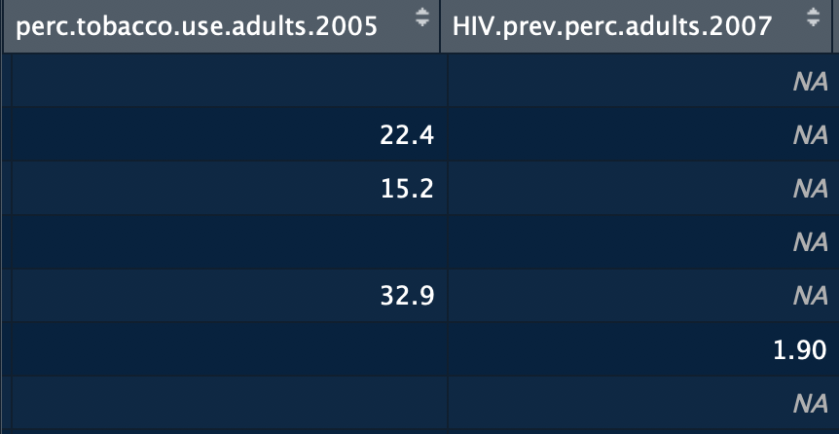
Replacing Missing Values
You may need to change missing values to zeros, blanks, or string “NA” values
Why?
  If you loop over values, NA will terminate the loop
  You may know that your NA values should actually be zero
The code below changes the NA values to a blank value

Slide 24
Questions?

