Slide 1
Intermediate R Webinar
User-Defined Functions
By Kelsey Huntzberry

Slide 2
What Are User-Defined Functions?
Functions that the user defines
Often contain multiple functions
Returns an object as the result
Can be used when R does not have a function to perform a task
Can also be used to avoid duplication
  Rule of thumb: If you copy/paste code more than twice, make a user-defined function

Slide 3
Today’s Data Set: TEDS
Today’s data set is the Treatment Episode Data Set (TEDS) from 2017
Collected by the Substance Abuse and Mental Health Services Administration
Includes all publicly funded admissions to substance abuse treatment facilities
Some states also collect all admissions from facilities that receive public funding
Can be obtained here

Slide 4
Today’s Data Set: TEDS
TEDS is a large data set (~2 million rows, 62 columns)
Am using the data.table package function fread() for loading .csv files
Much faster than read.csv()
  If your computer cannot handle a 308.2 MB data set, do not load it into R
Want to demonstrate how to repeat user-defined functions on large data frames and avoid loops

Slide 5
User-Defined Function Structure
Function Name
Arguments
To call the function:
sum.function <- function(x, y) {
result <- sum(x, y)
return(result)
}
sum.function(1, 2)
Will return: 3
Function Body

Slide 6
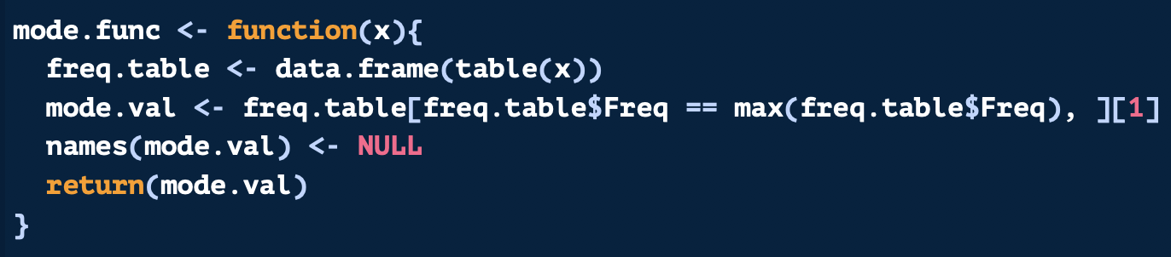
User-Defined Function Structure
No base R function for calculating the mode
Mode Definition: the most common element or data point in your data
Wrap function body with { }
Functions to perform in order
What object to return when function is run

Slide 7
Live Code Creation of a Function

Slide 8
Tips and Tricks
When writing a function, set actual values to be your arguments to test/write function
Run the insides of the function line by line, looking for errors
Delete these variables only when the body of the function works on one object/group
Do not use the function wrapper until the above is done

Slide 9
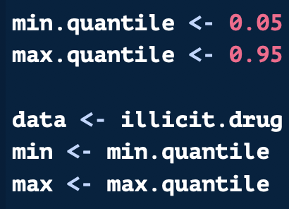
Building a Function: Walk Through
Final function will use min.quantile and max.quantile to change outlier cut offs
Not hard coding so new cut offs can easily be tried
Temporarily hard coding the future function arguments
Will be: function(data, min, and max)
Will use these temporarily for creating the function

Slide 10
Building a Function: Walk Through
Building the code with hard coded values
Making sure quantile function works and returns the 5th and 95th percentiles

Slide 11
Building a Function: Walk Through
Ensuring that filtering the data works
Remove outliers below and above the percentile cut offs
Once this works properly we can add this tested code into the function

Slide 12
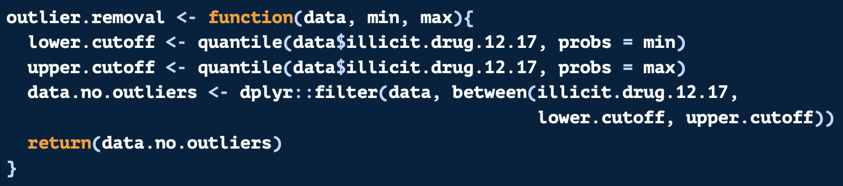
Building a Function: Walk Through
Naming the function outlier.removal
Dropping the code we just tested inside the function wrapper { }
Specifying a “return” value as the subsetted data frame
Remove hard coded data, min, and max values used for testing

Slide 13
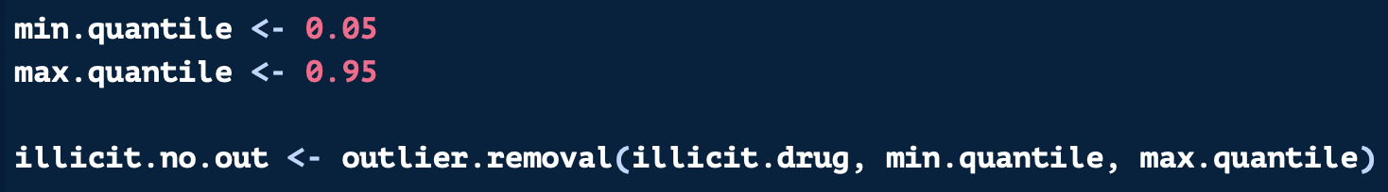
Building a Function: Walk Through
Now we can use the function we made!
Setting our desired percentile cut offs
Adding cut offs and our data set as the function arguments
  Correspond to data, min, and max when we built our function

Slide 14
Running Code by Group
Another common use for user-defined functions is running a chunk of code by group
  Prevents creation of complex loops
Create a user-defined function for the code chunk to be repeated
Use a group_map() from the purrr package to run by group
See cheatsheet in shared drive for more on purrr

Slide 15
group_map() from purrr package
Group to repeat function over
Returns grouping variable as column in your results
log.reg.results <- teds.sm %>%
group_by(sub1) %>%
group_modify(~log.reg.function(.), keep = TRUE)
Runs code by group and creates a matrix
User-defined function
Period shows that results from previous line of code should be placed here

Slide 16
User-Defined Functions & apply Functions
User-defined functions are often used with the apply family
Can use them in apply(), lapply(), sapply(), etc.
Repeats the functions for each row or column
Today, I will show an example from the parallel processing version of apply()

Slide 17
What is Parallel Processing?
apply() for example loops over the 1st row
Once it finishes with the 1st row, moves onto the 2nd row, etc.
Parallel processing runs multiple rows simultaneously so it will complete more quickly
Uses multiple cores
If you have 4 cores, will run 4 objects at a time
Done with the parallel package in R

Slide 18
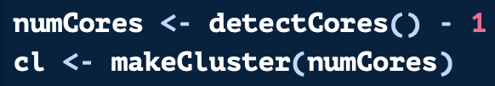

What is Parallel Processing?
Should run on the number of available cores minus one:
To start a cluster:
To stop a cluster:

Slide 19
apply() Functions with Parallel Package
Base R apply() Function | Parallel Package apply() Function | Purpose
apply() | clusterApply | Runs on rows or columns in an array or matrix
lapply() | parLapply() | Runs a function over a vector or list, returns a list
sapply() | parSapply() | Runs a function over a vector or list, returns vector
rapply() | parRapply() | Runs a function by rows of a data frame or matrix

Slide 20
Parallel Processing with apply
Runs sum function over each column in teds.flags data frame
Runs sum function by row in teds.flags data frame

