Slide 1
Statistics in R
The t-test
By Kelsey Huntzberry, MPH

Slide 2
Class Live Stream & Files Link
To access the live stream and files for class go to my website: www.kelseyhuntzberry.com/data-science-classes/

Slide 3
Review of Last Week’s Material

Slide 4
Avoiding Bias
There are widely accepted statistical procedures in place to avoid bias when performing statistical tests
Data Analysis with R lists guidelines
  Assume the opposite of what you are testing
  (Try to) show the results that you receive are unlikely given that assumption
  Reject the assumption
Notes:
Give Github link on slidesou

Slide 5
Null & Alternative Hypotheses
Null Hypothesis (H_{O}):
  Assumes that any difference or significance is due to chance alone
  Default hypothesis
  Have to assume it is true unless proven otherwise
  Have to establish statistical significance in order to reject the null hypothesis
Notes:
Give Github link on slidesou

Slide 6
Null & Alternative Hypotheses
Alternative Hypothesis (H_{a}):
  Opposite of the null hypothesis H_{O}
  States that a test statistic is smaller, greater, or different than the hypothesized value in the null hypothesis
  What we can conclude if we prove statistical significance and reject the null hypothesis
  What you hope to prove
Notes:
Give Github link on slidesou

Slide 7
Types of Errors

Slide 8
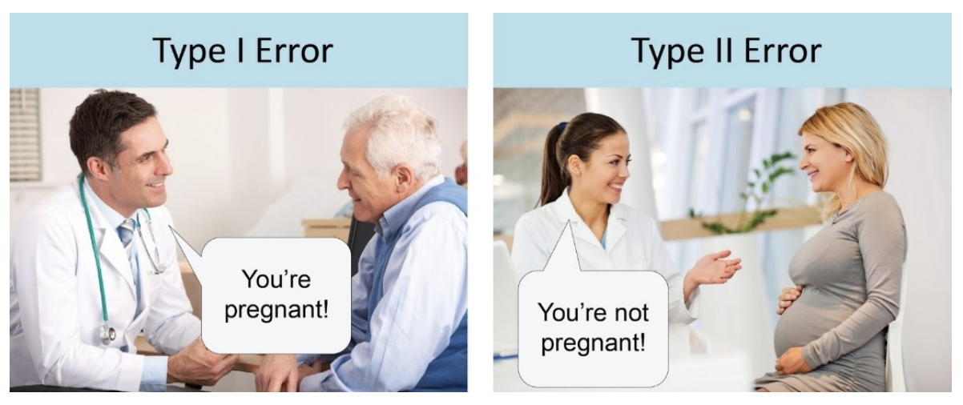
Type I & Type II Error
Type I Error: False Positive
  Mistakenly rejected the null hypothesis in favor of the alternative hypothesis
Type II Error: False Negative
  Failing to reject the null hypothesis when you should have done so
Notes:
Give Github link on slidesou

Slide 9
Type I & Type II Error
Should pay attention what types of errors your test is creating
Errors on mammograms to detect breast cancer:
  False positive rate: 7-12%
    Means mammogram is positive but the patient does not have breast cancer
      Highly dependent on age
      Younger women more likely to have false positive results
  False negative rate: 13%
    Means mammogram is negative and the patient does have breast cancer
Notes:
Give Github link on slidesou

Slide 10
Error Types: Breast Cancer Example
Both types of mammogram errors are costly
  False positives → Unnecessary medical tests, stress
  False negatives → Higher likelihood of death, debilitating illness
However, if you were testing the technology, false negatives are more costly
  Lives are at stake
Would want to analyze your data with this in mind
Notes:
Give Github link on slidesou

Slide 11
P-Values & Statistical Significance

Slide 12
The Goal: Statistical Significance
Null and alternative hypotheses help you set up an experiment or analysis to answer questions systematically
The goal is to prove that something is statistically significant
This means that our results were extreme enough that they likely did not occur by chance
Quantify this using p-values
Notes:
Give Github link on slidesou

Slide 13
P-Value Cut Offs
General cut offs:
  The standard cut off for something to be statistically significant is a p-value of 0.05
    i.e. 1.96 standard deviations away on either side
  p < 0.10 is generally considered marginally significant
  p < 0.01 is considered highly significant
Notes:
Give Github link on slidesou

Slide 14
P-Value Cut Offs
Nothing magic about 0.05
Your tolerance for error will depend on your use case
  Bigger risk to misidentify a cancer drug as being effective than whether one soda commercial increases sales more than another
  Would want a lower p-value in the case of a cancer drug
Notes:
Give Github link on slidesou

Slide 15
T-Test: Difference between Two Means

Slide 16
What Is a T-Test?
A t-test is used to compare means from two samples
Possible research questions:
  Is group 1 mean significantly different than group 2 mean? (two-tailed test)
  Is group 1 mean significantly greater than group 2 mean? (one-tailed test)
  Is group 1 mean significantly less than group 2 mean? (one-tailed test)
Used to compare continuous or numeric values from two groups
Notes:
Give Github link on slidesou

Slide 17
Independence Is Required
Both samples compared in a t-test must be independent of one another to run a student’s t-test
This means one sample’s values cannot dependent or affect the other sample’s values
If they are not independent, another test must be used
Notes:
Give Github link on slidesou

Slide 18
Test Normality Assumption
Data must be normal if samples size is less than 30
  Data distribution should look similar to a bell curve
If the sample size is greater than 30, the central limit theorem applies
  The conclusions will be valid even if your data is not normal
Notes:
Give Github link on slidesou

Slide 19
Test Normality Assumption
If the sample size is less than 30, you must determine if your data is normal
Test with qqPlot() function from car package
  If data follows a relatively straight line, means data is normal
  Patterns mean your data is NOT normal
With small sample sizes can use shapiro.test() function from car package
  Runs a Shapiro Wilk test
  If p-value less than 0.05, your data is not normal
Notes:
Give Github link on slidesou

Slide 20
Test Normality Assumption: Normal QQ-Plot
Notes:
Give Github link on slidesou

Slide 21
Test for Homogeneity of Variances
Variance is calculated by taking:
Variances of the two groups must be roughly equal
Can test with Levene’s Test with leveneTest() function from car package
  If p-value is less than 0.05, then the variances are not equal
Variance = (Value₁ – Mean)² + (Value₂ – Mean)² + (Value₃ – Mean)² + … (Value_{n})²
Number of Observations
Notes:
Give Github link on slidesou

Slide 22
What If Variances Are Not Equal?
If variances are not equal between the two groups use a Welch’s t-test
Adjusts standard errors and degrees of freedom (sample size minus 1) to make the test more robust
If there are unequal variances, will be harder to achieve significance
If variances are equal, the results from a Welch’s t-test should look very similar to a student’s t-test
Notes:
Give Github link on slidesou

Slide 23
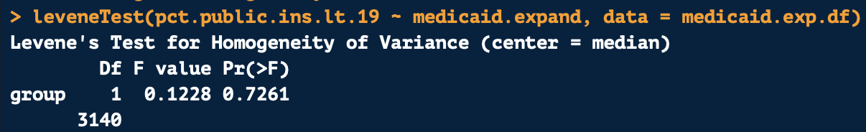
Checking for Equal Variances
We run a Levene’s Test to check for equal variances
Dependent Variable
Grouping Variable
Data
P-Value is above 0.10 So Variances Are Equal
Notes:
Give Github link on slidesou

Slide 24
Running a T-Test with Equal Variances
We want to compare mean Medicaid enrollment for children in expansion versus non-expansion states
Use the t.test() function to run a t-test
Set var.equal as TRUE since variances between two groups are equal
Dependent Variable
Grouping Variable
Data
Variances Are Equal
Notes:
Give Github link on slidesou

Slide 25
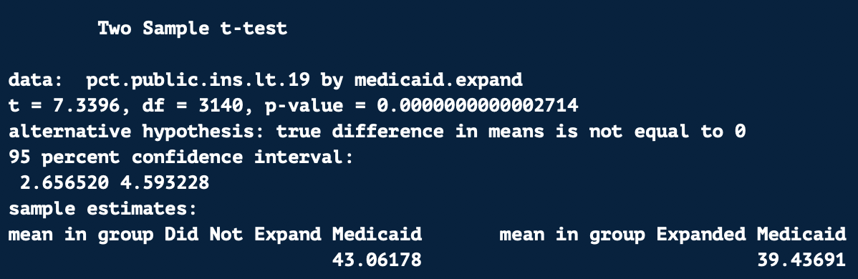
Running a T-Test in R
P-value is below 0.001 so result is highly significant
Mean enrollment in expanded Medicaid group is significantly lower than the mean in the group that did not expand Medicaid
  I know this seems weird but I will explain why!
Notes:
Give Github link on slidesou

Slide 26
T-Test with Variances That Are Not Equal

Slide 27
Test Normality Assumption: Normal QQ-Plot
Notes:
Give Github link on slidesou

Slide 28
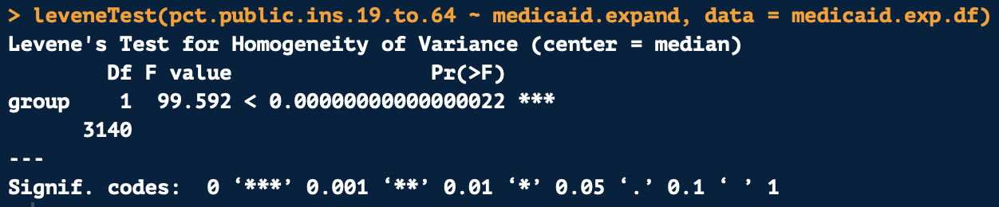
Checking for Equal Variances
We run a Levene’s Test to check for equal variances
Dependent Variable
Grouping Variable
Data
P-Value Is Below 0.10 So Variances Are NOT Equal
Notes:
Give Github link on slidesou

Slide 29
Running a T-Test when Variances Are Not Equal
We want to compare mean Medicaid enrollment for adults in expansion versus non-expansion states
Use the t.test() function to run a t-test
Set var.equal as FALSE since variances between two groups are equal
Dependent Variable
Grouping Variable
Data
Variances Are NOT Equal
Notes:
Give Github link on slidesou

Slide 30
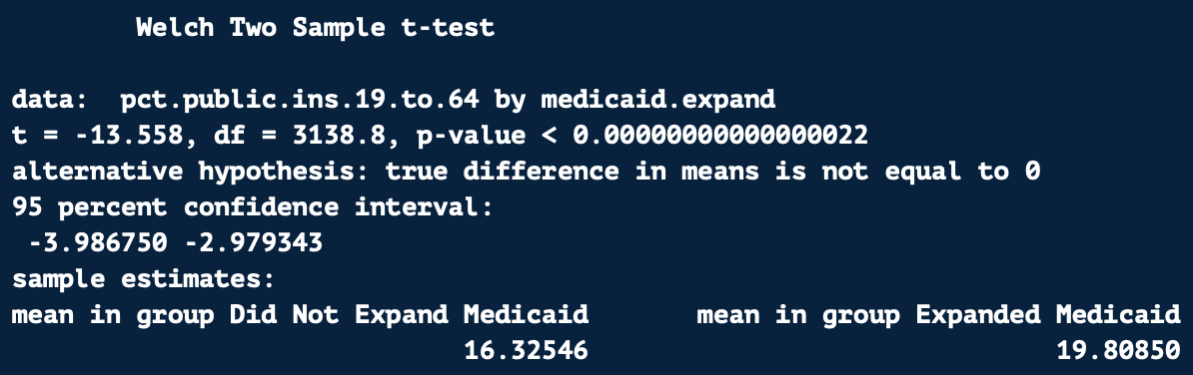
Running a T-Test in R
P-value is below 0.001 so result is highly significant
Mean enrollment in expanded Medicaid group is significantly greater than the mean in the group that did not expand Medicaid
Notes:
Give Github link on slidesou

Slide 31
Paired T-Test

Slide 32
Running a T-Test with Paired Data
If you want to compare data from multiple time points from the same individuals, you should use a paired t-test
A paired t-test is designed to analyze paired, non-independent data
Summary of method
  Calculates the differences between the two time points (simple subtraction)
  Runs a one-sample t-test to test if these differences are significantly different from zero
Notes:
Give Github link on slidesou

Slide 33
Paired T-Test Example
Will compare data of reaction times before and after individuals drank 2 beers
Want to determine if reaction times before beers are significantly different than after beers
To do this, we will use a paired t-test
Data from: https://bolt.mph.ufl.edu/6050-6052/unit-4b/module-13/paired-t-test/
Notes:
Give Github link on slidesou

Slide 34
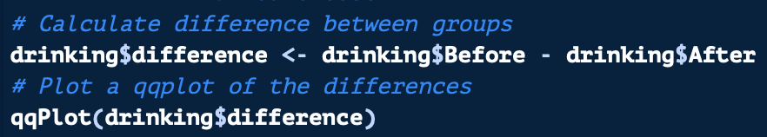
Test Normality: QQ-Plot on Paired Data
Notes:
Give Github link on slidesou

Slide 35
Running a Paired T-Test
x will equal time or observations from group 1 and y will equal time or observations from group 2 from the pairs
For paired t-test set as paired = TRUE
Notice that for paired test have to have x and y in separate vectors
  Meaning will need one column for time 1 and one column for time 2
Time 1 / Observation 1
Time 2 / Observation 2
Mark As Paired Data
Notes:
Give Github link on slidesou

Slide 36
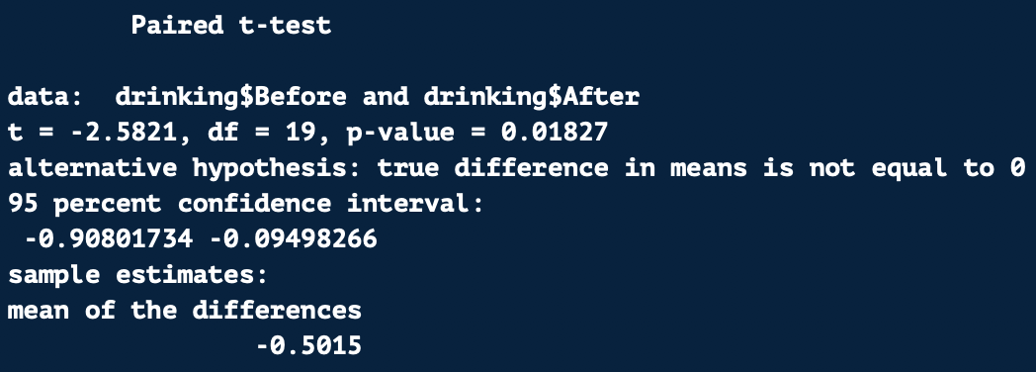
Running a T-Test in R
P-value is below 0.05 so result is significant
Difference between pairs is significantly different than zero
Therefore reaction time is significantly slower after two beers
Notes:
Give Github link on slidesou

Slide 37
T-Test with
Non-Normal Data

Slide 38
What If Data Is Not Normal?
If your data is not normal and your sample size is above 30, you can use a normal t-test
If your sample size is below 30 and not normal, you need to use a special test
  Two sample means: Mann Whitney U
  Paired samples: Wilcoxon Test
Similar to other t-tests but designed for non-normal data
Uses rankings to determine significance instead of raw differences
Notes:
Give Github link on slidesou

Slide 39
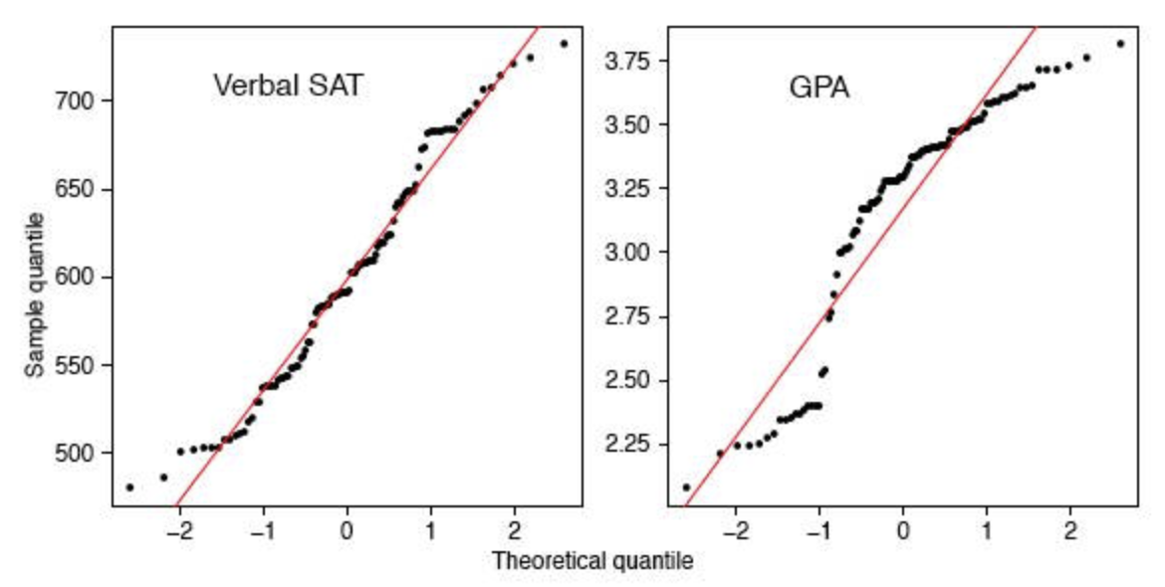
Normal
Not Normal
Image from: http://onlinestatbook.com/2/advanced_graphs/q-q_plots.html
Notes:
Give Github link on slidesou

Slide 40
Review In-Class Exercises

Slide 41
Task: Water Quality in Austin, TX
I asked you to compare the mean dissolved oxygen levels in Lady Bird Lake versus Barton Creek watersheds
First, you would check the sample size
  Sample size is 279 so normality not a concern
Use Levene’s Test to check for homogeneity or equal variances
Run independent samples t-test to compare two watersheds
Use var.equal = TRUE or var.equal = FALSE depending on Levene’s Test results
Notes:
Give Github link on slidesou

Slide 42
Test Normality Assumption: Normal QQ-Plot
Data is not normal but the sample size is 279, so if variances are equal can run a normal t-test
Notes:
Give Github link on slidesou

Slide 43
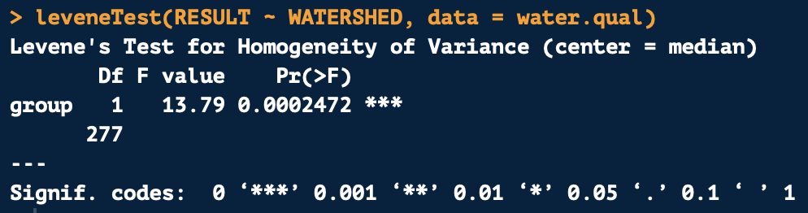
Checking for Equal Variances
We run a Levene’s Test to check for equal variances
Dependent Variable
Grouping Variable
Data
P-Value Is Below 0.10 So Variances Are NOT Equal
Notes:
Give Github link on slidesou

Slide 44
Running a T-Test with Equal Variances
We want to compare mean dissolved oxygen in Barton Creek versus Lady Bird Lake in Austin
Use the t.test() function to run a t-test
Set var.equal as FALSE because variances not equal
Dependent Variable
Grouping Variable
Data
Variances Are NOT Equal
Notes:
Give Github link on slidesou

Slide 45
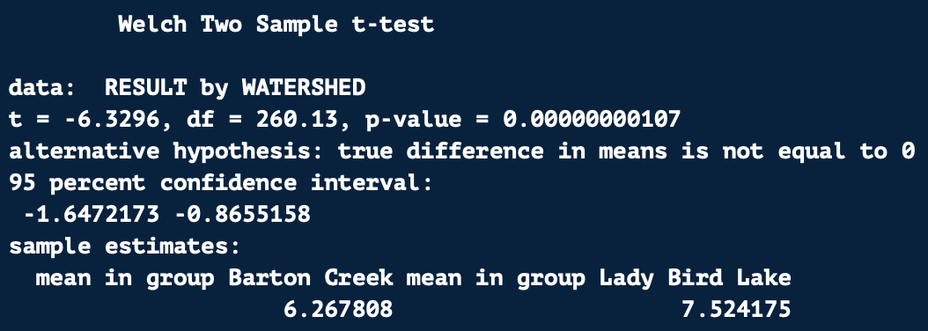
Running a T-Test in R
P-value is below 0.001 so result is highly significant
Mean dissolved oxygen in Lady Bird Lake is significantly higher than the mean in Barton Creek
Notes:
Give Github link on slidesou

Slide 46
Questions?

