Slide 1
Statistics in R
Descriptive statistics, probability, & r Basics
By Kelsey Huntzberry, MPH

Slide 2
Class Live Stream & Files Link
To access the live stream and files for class go to my website: www.kelseyhuntzberry.com/data-science-classes/

Slide 3
Installing Base R and RStudio

Slide 4
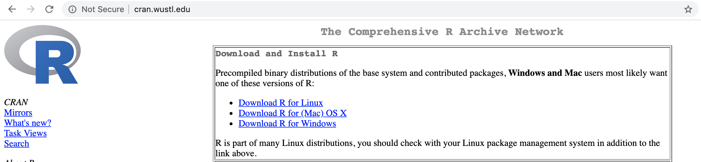
Installing Base R
Go to this link: http://cran.wustl.edu
  With this CRAN, can be set up with one file
  Easy and straightforward
Choose “Download R” link for your operating system
Notes:
Give Github link on slidesou

Slide 5
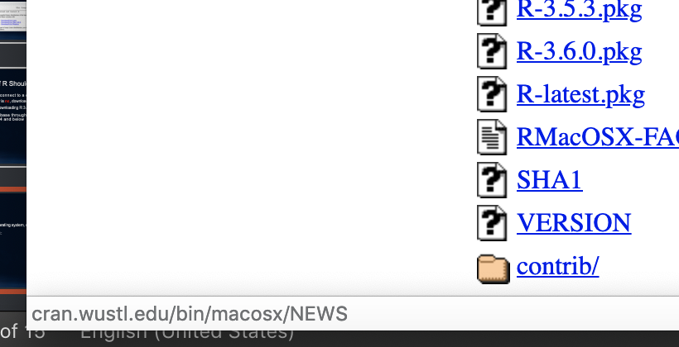
Downloading Base R on Mac
Latest version:
  After you choosing operating system, click R-latest.pkg link towards the bottom of your screen

Slide 6
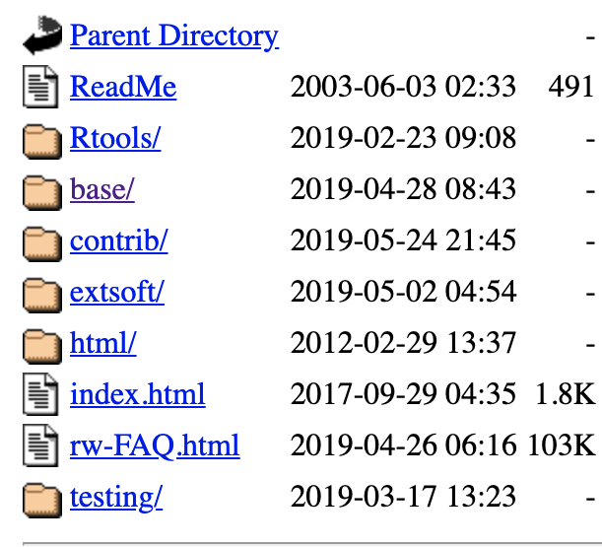
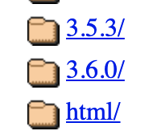
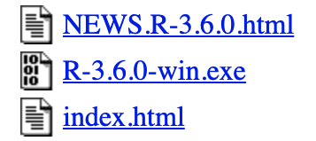
Downloading Base R on Windows, Newest Version
Latest version (use this if you DO NOT want to connect to a database):
  After you choosing operating system, click “base/” button
  Click “old/”
  Click 3.6.0/
  Click “R-3.6.0-win.exe”

Slide 7
Downloading Base R
After you click the link:
  Let the download finish
  Open file
  Follow on-screen instructions

Slide 8
Difference between Base R & RStudio
Base R allows the program to run on your computer
You can program in Base R but I do not recommend it
  It is difficult to use!
We will use Rstudio:
  An interface that is easy to use
  Can easily see:
    Code
    Results
    Plots
    Get help
Notes:
Give Github link on slidesou

Slide 9
Downloading RStudio
Go to this link: https://www.rstudio.com/products/rstudio/download/
I will be using RStudio Desktop
RStudio Server runs on the cloud
  You are welcome to use it if you prefer
  However, I will not be covering cloud-related troubleshooting in this course
Click Download to version you want
Choose your operating system
Let file load, open it, and follow on-screen instructions
Notes:
Give Github link on slidesou

Slide 10
Class Overview & My Background

Slide 11
What Will We Be Learning in this Class?
We are starting with very basic statistics and working our way up to more complicated concepts
Major topics:
  Descriptive statistics
  Probability
  Hypothesis testing
  Basic statistical tests
  Linear and logistic regressions
  Basics of predictive analytics and model validation

Slide 12
My Background
Education
  Double BA in political science and psychology from Swarthmore College
  Master in Public Health (MPH) with a specialization in Health Policy Analysis from Washington University in St. Louis

Slide 13
My Background
Work Experience
  Statistical Data Analyst at Washington University in St. Louis
  Data Scientist at Bayer Crop Science
  Current: Data Science Analyst at Whole Foods Market
Taught Intro to Data Science, Introduction to R, and Intermediate R to colleagues at Bayer Crop Science and Intro to R Programming here in Austin

Slide 14
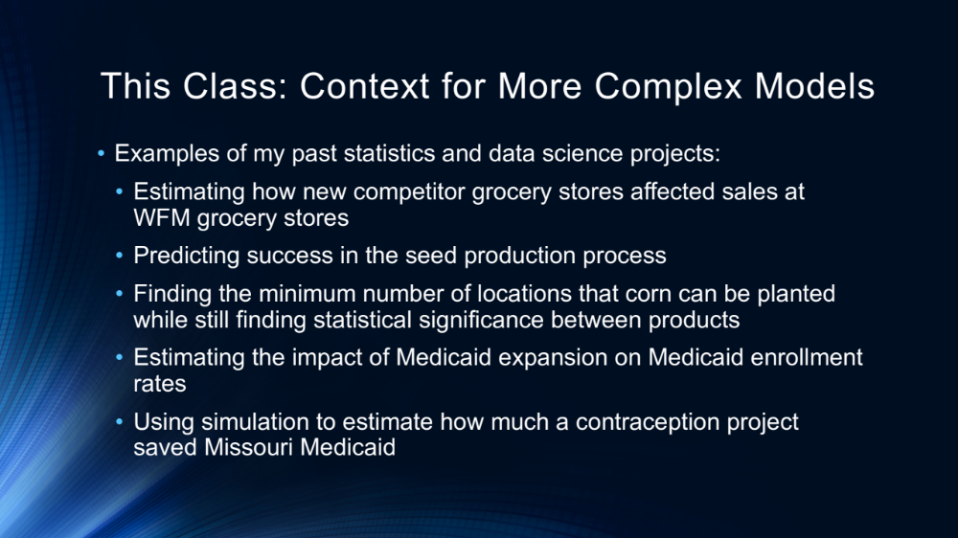
This Class: Context for More Complex Models
Examples of my past statistics and data science projects:
  Estimating how new competitor grocery stores affected sales at WFM grocery stores
  Predicting success in the seed production process
  Finding the minimum number of locations that corn can be planted while still finding statistical significance between products
  Estimating the impact of Medicaid expansion on Medicaid enrollment rates
  Using simulation to estimate how much a contraception project saved Missouri Medicaid

Slide 15
R Programming Webinars
I am offering Saturday R programming webinars on off-weekends for this course
Also adding online learning tutorials over time
Will offer both introduction and intermediate topics
For more information go to www.kelseyhuntzberry.com

Slide 16
Class Content
Instructional content in PowerPoint (slides shared 2 hours before class!)
Examples to demonstrate every major concept
Optional exercises to do at home and work on in class
  These will be reviewed during the next class
Time for extra help during class or after class at It’s a Grind Coffee House near Milwood Library
  More information here: https://kelseyhuntzberry.com/statistics-classes/

Slide 17
Class Resources
Will record each class and post on class OneDrive
Will also post all PowerPoints, code, and data files
We also have a Slack channel where:
  You can communicate and ask questions
  Prefer you to ask questions here so everyone can benefit
  I will communicate important course information to you
More information and links for these resources are located here: https://kelseyhuntzberry.com/data-science-classes/
Notes:
Give Github link on slidesou

Slide 18
Class Reading
Have provided textbook reading if you would like to have a primer on topics before class
  Optional assignment list on individual class descriptions at this link: https://kelseyhuntzberry.com/statistics-classes/
Data Analysis with R by Tony Fischetti
  A simple, plain English tutorial
  Will be basing the class material on this and other optional reading assignments
  Available here: https://www.packtpub.com/big-data-and-business-intelligence/data-analysis-r
Notes:
Give Github link on slidesou

Slide 19
More Advanced Reading
For a more advanced tutorial, I suggest Discovering Statistics Using R by Andy Field, Jeremy Miles, and Zoe Field
  Am NOT basing the course on this book
  Much more difficult and math-heavy
  Available here: https://www.amazon.com/Discovering-Statistics-Using-Andy-Field/dp/1446200469
Notes:
Give Github link on slidesou

Slide 20
Measures of Central Tendency

Slide 21
Finding the Mode
The main measures of central tendency, or the approximate center for your data, are mean, median, and mode
The mode is the most repeated value in a series of data
In the data below, 0.300 is the mode because it is repeated twice when the other values only occur once
Example:
Batting Averages: 0.220, 0.300, 0.260, 0.235, 0.280, 0.300

Slide 22
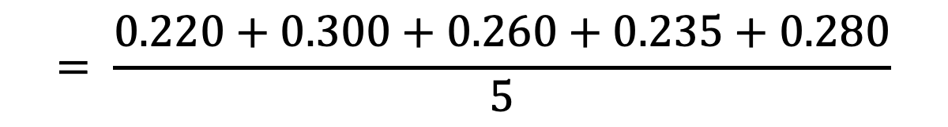


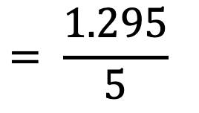
Calculating the Mean
$$Mean= \frac{Sum of all values in your sample}{Number of data points in your sample}$$
Example:
Batting Averages: 0.220, 0.300, 0.260, 0.235, 0.280
$$= \frac{0.220+0.300+0.260+0.235+0.280}{5}$$
$$= \frac{1.295}{5}$$
Mean
$$=0.259$$

Slide 23
Calculating the Median
The main measures of central tendency, or the approximate center for your data, are mean, median, and mode
If you sort or order your data from smallest to largest the median is the value in the center location
If you have 5 values, the 3rd value will be the median
Example:
Batting Averages: 0.220, 0.235, 0.266, 0.280, 0.300
1
2
3
4
5

Slide 24
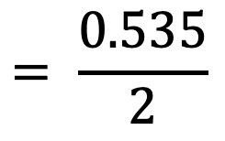
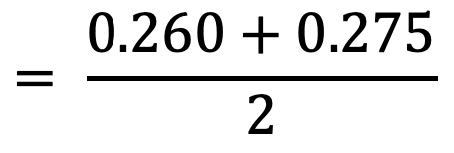

More about the Median
If there is an even number of values, the mean of the two center values is the considered the median
For example, if 6 values are sorted from smallest to largest, the mean of the 3rd and 4th values is the median
Example:
Batting Averages: 0.220, 0.235, 0.260, 0.275, 0.285, 0.300
1
2
3
4
5
6
$$= \frac{0.260+0.275}{2}$$
$$= \frac{0.535}{2}$$
Median
$$=0.268$$

Slide 25
Complete Exercise #1 in R Code

Slide 26
Measures of Spread

Slide 27


Measures of Spread
Measures of spread tell you how spread out your data is
In other words, it tells you how far apart on average your data points are from one another

Slide 28




Quartiles
Quartiles are at the 25th, the 50th (median), and 75th percentiles
Percentile is the percent of data below a value
Below, 25% of the data is below 58 and 75% of the data is below 64
Example:
Heights: 55, 56, 58, 59, 60, 63, 64, 65, 75
1
2
3
4
5
6
7
8
9

Slide 29
Measures of Spread: Interquartile Range (IQR)
The IQR or interquartile range is the 75th percentile minus the 25th percentile
Below, the IQR equals 6
Example:
Heights: 55, 56, 58, 59, 60, 63, 64, 65, 75
1
2
3
4
5
6
7
8
9

Slide 30
Outliers
Outliers are values that are far away from the other data points
Quartiles and the IQR help us define outliers
Lower Outliers Are Less Than:
  25th Percentile – (1.5*1QR)
Upper Outliers Are Greater Than:
  75th Percentile + (1.5*1QR)
Our Example:
25th Percentile: 58
75th Percentile: 64
IQR: 6
Lower Outliers
58 – 6*1.5 = 49
Any values less than 48 are outliers
Upper Outliers
64 + 6*1.5 = 73
Any values greater than 73 are outliers
Therefore, value 75 is an outlier

Slide 31
Boxplots and Quartiles
Boxplots show the distribution of your data
The lines represent the values we just learned about, the quartiles and outliers
75th Percentile
Median
25th Percentile
Outlier

Slide 32
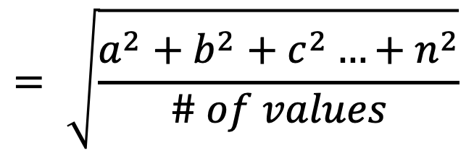
Measuring Spread: Standard Deviation
Measures of spread tell you how spread out your data is
In other words, it tells you how far apart on average your data points are from one another
The standard deviation measures spread
The higher your value, the more spread out your data is
$$= \sqrt{\frac{a^{2}+b^{2}+c^{2}…{+ n}^{2}}{\# of values}}$$
Standard Deviation

Slide 33
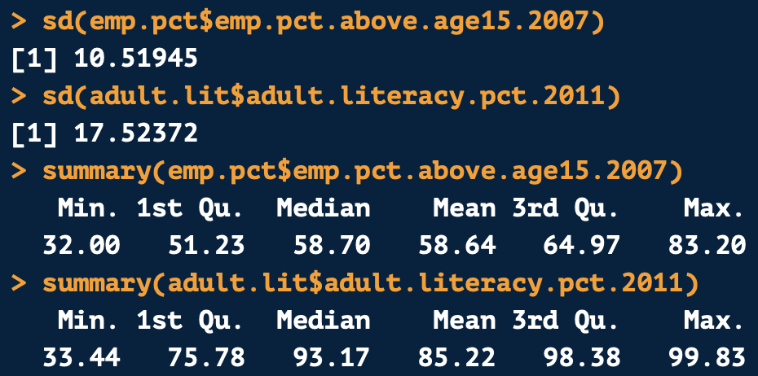
Standard Deviation Example
The world adult literacy percent in 2011 has a higher standard deviation than the world employment percent in 2007
To see why, look at the data summaries:
  Most literacy data points are above 75%, but there are really low outliers
  The employment percent is more symmetric
  The range of values for adult literacy percent is also higher
World Employment %, 2007
World Adult Literacy %, 2011

Slide 34
Outlier Sensitivity
The mean and standard deviation are very sensitive to outliers
A few extreme outliers will pull the mean and standard deviation towards those outliers
The median and IQR are not sensitive to outliers
  They stay in the same position even if there are a few extreme outliers
If you have extreme outliers, the mean and standard deviation will not accurately represent your data
  If possible, use the median or IQR instead

Slide 35
Complete Exercises #2 and #3 in R Code

Slide 36
Data Shapes

Slide 37
Symmetric Data
The data distribution looks relatively equal on the right and left part of the graph
The mean and median are approximately equal

Slide 38
Right Skewed
Left Skewed
The mean is to the right of the median
There are many outliers extending the graph out to the right to the higher numbers
The mean is to the left of the median
There are many outliers extending the graph out to the left to the lower numbers

Slide 39
Complete Exercises #4 in R Code

Slide 40
Basic Terms Explained

Slide 41
Continuous vs. Categorical Data
Categorical data are when your data is divided into groups or categories
  Example: The gender variable in the box plot data is categorical
Continuous or numeric data are when your data is assigned a number value
  Example: The mean years of schooling variables in the world data was continuous

Slide 42
Populations vs. Samples
Populations include all values in a group
  Example: Giving course evaluations to all students in a school to assess satisfaction with teaching in that school
    Why is this a population? We are sampling all students
Samples include a subset or smaller group from the entire population
  Example: Nielsen surveys a random sample of households to estimate the TV viewership of the US as a whole
    Why is this a sample? We are not surveying all people in the US

Slide 43
Why Use Samples?
We use samples to get useful information and make inferences about a population
Next week we will go over standards for choosing a sample so it will accurately represent the population

Slide 44
Probability Rules

Slide 45
What is Probability?
Probability is the likelihood that something will happen
Written as a number between 0 and 1
Example: If you flip a fair coin, the probability it will land on heads is 0.5 or a 50% chance

Slide 46
Independence
When one chance event does not affect the probability of another chance event occurring, the two events are independent
Example: The result of one coin flip will not affect the next coin flip (unless you are superstitious!)
This is an important concept in statistics!

Slide 47
Replacement
When multiple chance events occur, replacement is important
When you pick two cards in a row:
  If you are using replacement, the card will be returned to the deck after the first draw
  If you are not using replacement, the card will be removed from the deck once drawn
Why does this matter?
  The probability of drawing an ace from a deck of cards is 4/52
  If I draw a King and do not replace it, the probability of pulling an ace the second time will be 4/51, slightly better

Slide 48
Probability of Two Independent Events
With two independent events, multiply both independent event probabilities together to calculate the probability of both occurring
Example:
  The probability of a coin flip being heads once is 0.5
  The probability of flipping heads two times in a row is:
    0.5*0.5 = 0.25

Slide 49
Mutually Exclusive
Mutually exclusive events are events that cannot occur at the same time
When flipping a coin, heads and tails are mutually exclusive
A coin cannot land on heads and tails at the same time

Slide 50
R Probability Demonstration

Slide 51
R Interface & Essential Basic Commands

Slide 52
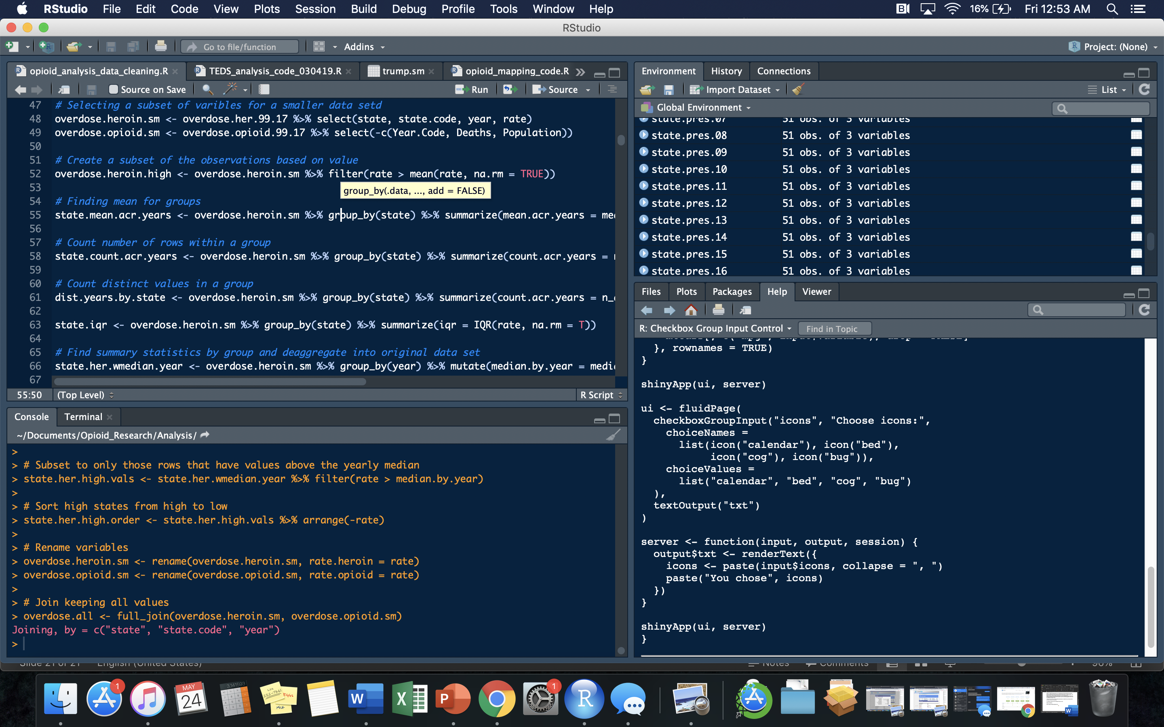
Workspace: All objects in your environment will be found here. Shows more information about data types and contents if you click on blue arrow.
Source Brower: You will create and interact with your R scripts and projects here
Console: You can type code directly in this area. Recommended for quick testing only. Will not be saved for further use.
Interact with your files, help documents, packages, and see plots here.

Slide 53
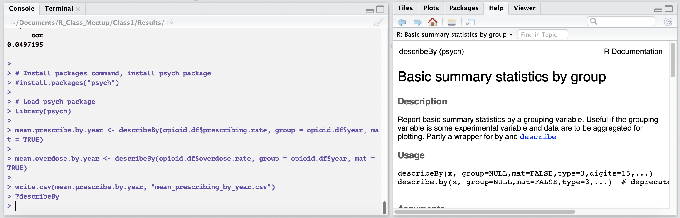
Accessing Help Inside R
You can access help files inside R
Type ? then the package you want help on in the console
Example:
Notes:
Give Github link on slidesou

Slide 54
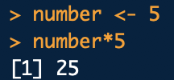
Most Basic Elements
In R use <- or = to assign values to a variable
  Data science best practice is to use <-
  Example: state <- “Texas”
To refer to a single variable within a data frame, use $
  Example: data.frame$variable
Can perform arithmetic on values
Notes:
Give Github link on slidesou

Slide 55
All about Vectors
The most basic element in R is a vector
All other elements are made up of vectors
Vector: Series of multiple values of the same type in one dimension
Variable Name
Assignment
Vector Values
Notes:
Give Github link on slidesou

Slide 56
Set Your Working Directory
Connect RStudio to a specific folder on your computer by setting a working directory
Can directly:
  Import files into RStudio from folder
  Export files into folder from RStudio
Structure for Windows:
  setwd("C:\\Documents\\Data_Folder")
Structure for Mac:
  setwd("~/Documents/Data_Folder")
Check working directory by using getwd()
NOTE: You can use / or \\ to set working directory (directly pasting a file path will NOT work!)
Notes:
Give Github link on slidesou

Slide 57
Importing Data
To import a .csv file from your working directory use this code format:
new.df <- read.csv(“name_you_want_for_your_file.csv”)
Example:
opioid.df <- read.csv("state_prescribe_overdose_data.csv”)
You can also add a file path to send to another folder!
Add stringsAsFactors = F to import strings as characters instead of factors
opioid.df <- read.csv("state_prescribe_overdose_data.csv", stringsAsFactors = F)
Notes:
Give Github link on slidesou

Slide 58
Exporting Data
To export a data frame to .csv format into your working directory use the following command and format:
write.csv(r.data.frame.for.export, “name_you_want_for_your_file.csv”)
Example:
write.csv(mean.overdose.by.year, "mean_overdose_by_year.csv")
You can also add a file path to send to another folder!
Notes:
Give Github link on slidesou

Slide 59
Installing & Loading Packages
To install an R package, follow this format:
install.packages(“psych”)
To load the package into your R session use this format:
library(psych)
You have to install your packages once
You have to load your packages every time you open a new R session
If you close R, you will have to load your packages again
Notes:
Give Github link on slidesou

Slide 60
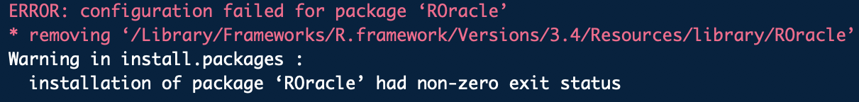
Package Loading Error?
If you see an error like what you see below:
Your package requires dependencies!
This package requires updated Java, Rtools, and several other R packages
  These have to be loaded first before you can install the package
Google it!
Notes:
Give Github link on slidesou

Slide 61
Commonly Used Packages
ggplot2
  Used to create customized graphs
dplyr
  Used for data cleaning, modeling, big data work
stringr
  Used for string manipulation
data.table
  Runs large data sets quickly
rmarkdown
  Chunks code
  Can create an HTML print out of code paired with its output
Notes:
Give Github link on slidesou

Slide 62
Coding Demonstration in R

Slide 63
Questions?

Slide 64
Thank you for attending!
Next Statistics Class is Hypothesis Testing & Inference:
Next Saturday, August 17th from 10:00 AM to 12:30 PM
Connect using the same link as today!

Slide 65
Contact Info:
My email: kelsey.Huntzberry@gmail.com
Slack Channel to collaborate with your cohort is called r-programming-class found here: https://join.slack.com/t/learningrinaustin/shared_invite/enQtNjQ3MTcxMTczOTQyLTU4NWU2OGU5ZWQ5YzIwMTRhYjRiZTI3ODM1Yjc3ZTcwY2VjOGZkNjg2MzE1ODA1ZDA0YTRjMzNjYmIxOWQ1YmM

