Slide 1
Introduction to R
Setup, R Interface, and intro to basics
By Kelsey Huntzberry, MPH

Slide 2
Class Materials
All class materials can be found by clicking the “R Programming Class Powerpoints, Code, and Data” at the bottom of this page:
https://kelseyhuntzberry.com/data-science-classes/

Slide 3
What Will We Be Learning?
All the basics that beginners need to become regular R users!
Major topics:
  Data types and structures and how they are used
  Basic essential R functions
  Loading and exporting data
  Calculating descriptive statistics
  Graphing

Slide 4
My Background
Education
  Double BA in political science and psychology from Swarthmore College
  Master in Public Health (MPH) with a specialization in Health Policy Analysis from Washington University in St. Louis

Slide 5
My Background
Work Experience
  Statistical Data Analyst at Washington University in St. Louis
  Data Scientist at Bayer Crop Science
  Current: Data Science Analyst at Whole Foods Market
Taught Intro to Data Science, Introduction to R, and Intermediate R to colleagues at Bayer Crop Science

Slide 6
Introduction to R Programming: Class Outline
Class 1
  Review course outline
  Why learn R?
  Installing R
  R interface
  Intro to basics
Class 2
  Data types
  Data structures
Class 3
  Indexing
  Basic R functions
Class 4
  Missing values
  If/else statements
  Merging
  Row and column binds
Class 5
  All about graphing in ggplot2

Slide 7
Intermediate R Programming
After the first 5 classes are complete, we will proceed with intermediate topics such as:
  Data manipulation with dplyr
  String manipulation with stringr
  Loops
  User-defined functions
Eventually:
  RShiny
  Coding predictive models
  Parallel programming

Slide 8
Why Learn R?
Popular (Top 3 in Data Science)
Strong in graphics and statistics
Fast and efficient
Open source
Can be automated
Useful for careers in many fields!

Slide 9
Graphing
Uses for R Programming
Mapping
Machine Learning
Creating Website & Interactive Graphs with RShiny
Image Analysis
Statistical Analysis & Modeling
Deep Learning
Simulation & Resource Optimization
Notes:
Give specific example of something I have done in R in job setting

Slide 10
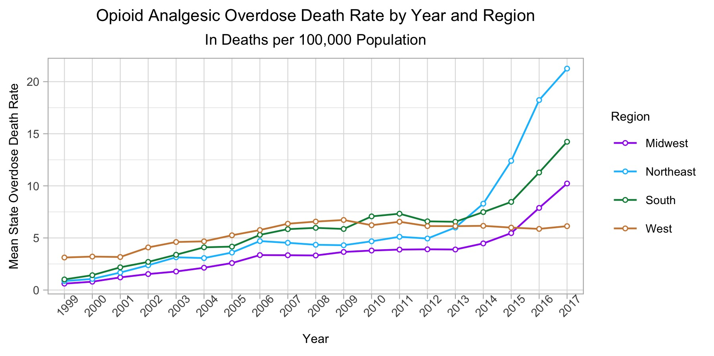

Slide 11
Class Content
Class content:
  Instructional content in PowerPoint on OneDrive
  Examples to demonstrate every major concept
  Optional exercises to do at home
    These will be reviewed during the next class

Slide 12
Streaming and Recording of Class
The same link will be used for all classes
I will post all code, PowerPoints, and data on the OneDrive before class begins
  The OneDrive link is at the bottom of the page at this link: https://kelseyhuntzberry.com/data-science-classes/
My class videos should be up within about a week of each class on my website
Notes:
Give Github link on slidesou

Slide 13
Collaboration
Slack channel for group chat
  Slack is a chat forum where you can ask questions
  Slack channel name: r-programming-class
  Slack channel link: https://join.slack.com/t/learningrinaustin/shared_invite/enQtNzE1MjAwMzU1NzMyLTI5MWUyOWJjYjliM2M0ZmY3ZmUzODQyM2JjMzNhY2QyYmZkMDFlNWVjYzNhMjNkMTNiYTgyYjM0OWY4MTZiNjc
Notes:
Give Github link on slidesou

Slide 14
Getting Help
Have a coding error you do not know how to solve?
Google it!
Best resources I have found are:
  Stack Overflow (https://stackoverflow.com/) *This one is often your best option!
  R Bloggers (https://www.r-bloggers.com/getting-help-with-r-programming-useful-survival-skills/)
  Quick R (https://www.statmethods.net/)
  STHDA (http://www.sthda.com/english/wiki/getting-help-with-functions-in-r-programming)
Notes:
Give Github link on slidesou

Slide 15
Installing Base R and RStudio
Slides 16-19 instruction you on how to download R
I will only be going over them briefly
Please reference slides after class if you have trouble
Can use R cloud interface to follow along if you cannot get it installed: https://rstudio.cloud/
  All you need is an account
Notes:
Give Github link on slidesou

Slide 16
Installing Base R & RStudio

Slide 17
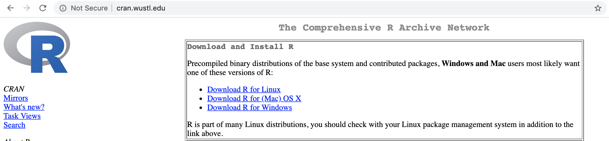
Installing Base R
Go to this link: http://cran.wustl.edu
  With this CRAN, can be set up with one file
  Easy and straightforward
Choose “Download R” link for your operating system
Notes:
Give Github link on slidesou

Slide 18
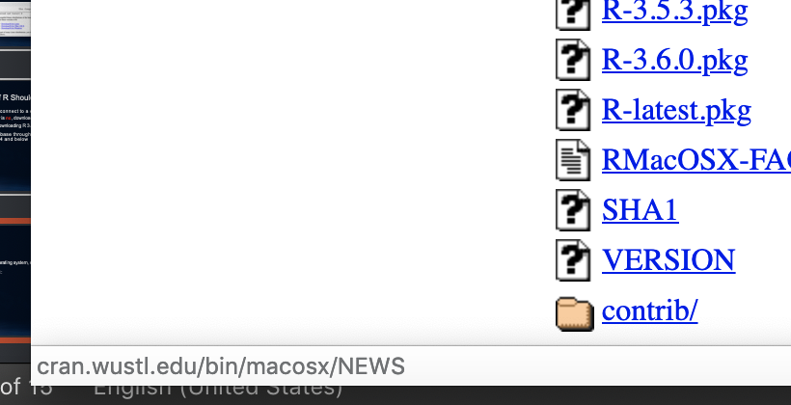
Downloading Base R on Mac
Latest version:
  After you choosing operating system, click R-latest.pkg link towards the bottom of your screen

Slide 19
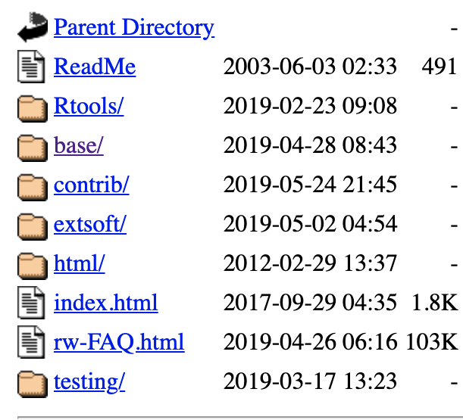
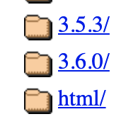
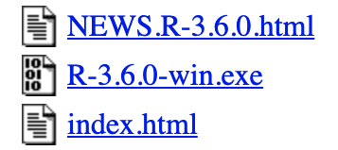
Downloading Base R on Windows, Newest Version
Latest version (use this if you DO NOT want to connect to a database):
  After you choosing operating system, click “base/” button
  Click “old/”
  Click 3.6.0/
  Click “R-3.6.0-win.exe”

Slide 20
Downloading Base R
After you click the link:
  Let the download finish
  Open file
  Follow on-screen instructions

Slide 21
Difference between Base R & RStudio
Base R allows the program to run on your computer
You can program in Base R but I do not recommend it
  It is difficult to use!
We will use Rstudio:
  An interface that is easy to use
  Can easily see:
    Code
    Results
    Plots
    Get help
Notes:
Give Github link on slidesou

Slide 22
Downloading RStudio
Go to this link: https://www.rstudio.com/products/rstudio/download/
I will be using RStudio Desktop
RStudio Server runs on the cloud
  You are welcome to use it if you prefer
  However, I will not be covering cloud-related troubleshooting in this course
Click Download to version you want
Choose your operating system
Let file load, open it, and follow on-screen instructions
Notes:
Give Github link on slidesou

Slide 23
R Interface & Essential Basic Commands

Slide 24
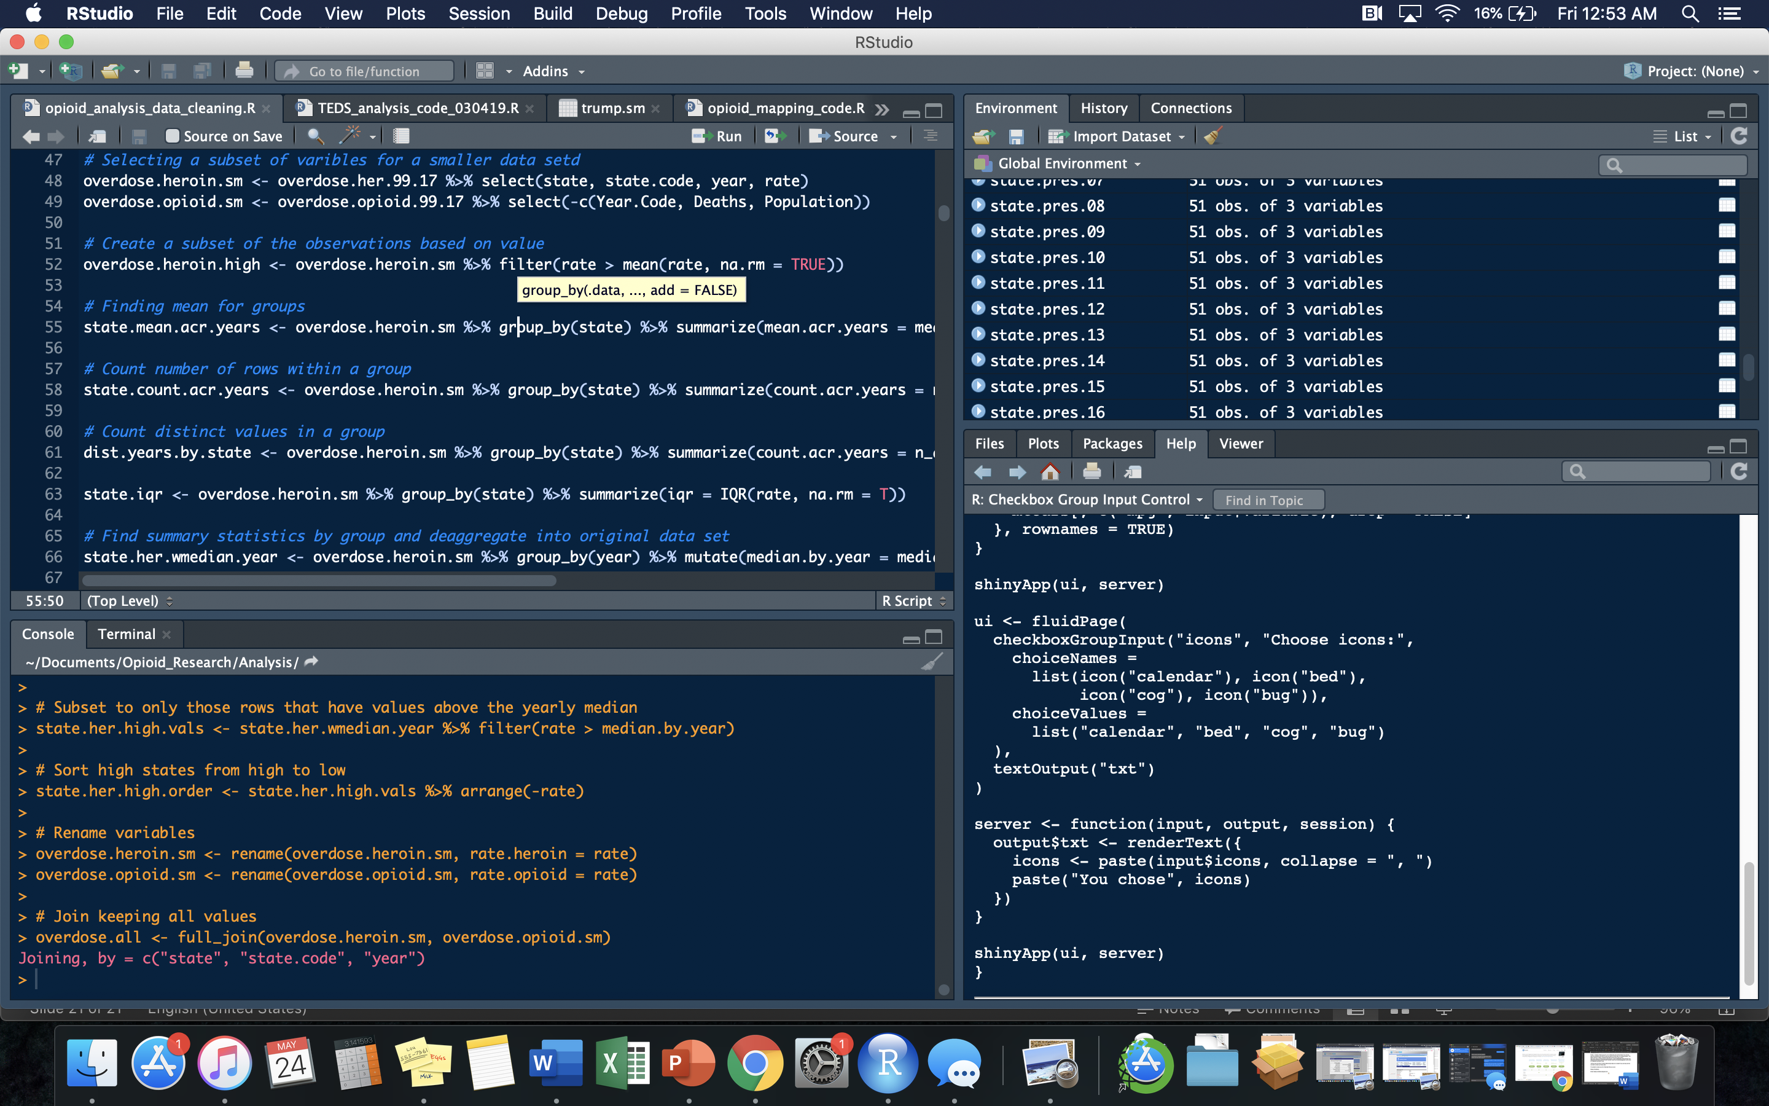
Workspace: All objects in your environment will be found here. Shows more information about data types and contents if you click on blue arrow.
Source Brower: You will create and interact with your R scripts and projects here
Console: You can type code directly in this area. Recommended for quick testing only. Will not be saved for further use.
Interact with your files, help documents, packages, and see plots here.

Slide 25
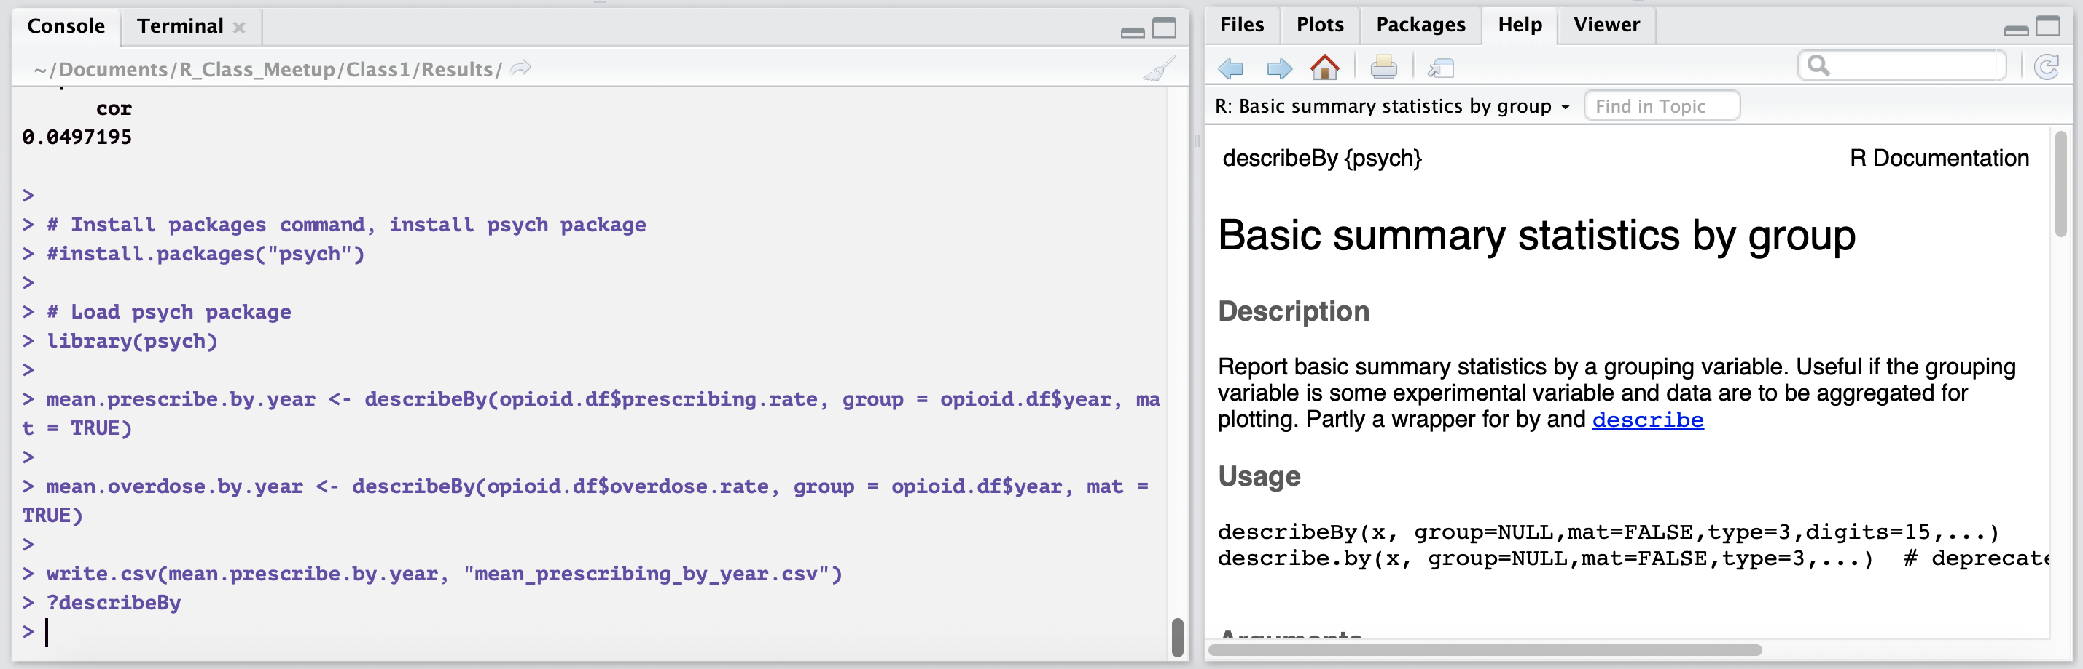
Accessing Help Inside R
You can access help files inside R
Type ? then the package you want help on in the console
Example:
Notes:
Give Github link on slidesou

Slide 26
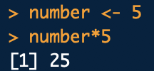
Most Basic Elements
In R use <- or = to assign values to a variable
  Data science best practice is to use <-
  Example: state <- “Texas”
To refer to a single variable within a data frame, use $
  Example: data.frame$variable
Can perform arithmetic on values
Notes:
Give Github link on slidesou

Slide 27
All about Vectors
The most basic element in R is a vector
All other elements are made up of vectors
Vector: Series of multiple values of the same type in one dimension
Variable Name
Assignment
Vector Values
Notes:
Give Github link on slidesou

Slide 28
Set Your Working Directory
Connect RStudio to a specific folder on your computer by setting a working directory
Can directly:
  Import files into RStudio from folder
  Export files into folder from RStudio
Structure for Windows:
  setwd("C:/Documents/Data_Folder")
Structure for Mac:
  setwd("~/Documents/Data_Folder")
Check working directory by using getwd()
NOTE: You can use / or \\ to set working directory (directly pasting a file path will NOT work!)
Notes:
Give Github link on slidesou

Slide 29
Importing Data
To import a .csv file from your working directory use this code format:
new.df <- read.csv(“name_you_want_for_your_file.csv”)
Example:
opioid.df <- read.csv("state_prescribe_overdose_data.csv”)
You can also add a file path to send to another folder!
Add stringsAsFactors = F to import strings as characters instead of factors
opioid.df <- read.csv("state_prescribe_overdose_data.csv", stringsAsFactors = F)
Notes:
Give Github link on slidesou

Slide 30
Exporting Data
To export a data frame to .csv format into your working directory use the following command and format:
write.csv(r.data.frame.for.export, “name_you_want_for_your_file.csv”)
Example:
write.csv(mean.overdose.by.year, "mean_overdose_by_year.csv")
You can also add a file path to send to another folder!
Notes:
Give Github link on slidesou

Slide 31
Loading & Installing Packages

Slide 32
Installing & Loading Packages
To install an R package, follow this format:
install.packages(“psych”)
To load the package into your R session use this format:
library(psych)
You have to install your packages once
You have to load your packages every time you open a new R session
If you close R, you will have to load your packages again
Notes:
Give Github link on slidesou

Slide 33
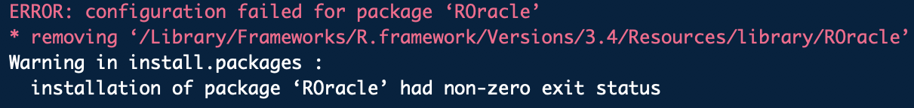
Package Loading Error?
If you see an error like what you see below:
Your package requires dependencies!
This package requires updated Java, Rtools, and several other R packages
  These have to be loaded first before you can install the package
Google it!
Notes:
Give Github link on slidesou

Slide 34
Commonly Used Packages
ggplot2
  Used to create customized graphs
dplyr
  Used for data cleaning, modeling, big data work
stringr
  Used for string manipulation
data.table
  Runs large data sets quickly
rmarkdown
  Chunks code
  Can create an HTML print out of code paired with its output
Notes:
Give Github link on slidesou

Slide 35
Coding Demonstration in R

