Slide 1
Intermediate R Webinar
Data Manipulation with dplyr
By Kelsey Huntzberry

Slide 2
File Location Link
The link to access today’s code, PowerPoint, and data files is available here: https://kelseyhuntzberry.com/data-science-classes/
SCROLL DOWN TO THE BOTTOM OF THE PAGE

Slide 3
RStudio Cheat Sheets
When I learned dplyr and other packages, made use of RStudio’s cheat sheet PDFs
  https://www.rstudio.com/resources/cheatsheets/
Also provided in the shared folder (see previous slide) an important dplyr functions Excel sheet that I created for myself when learning

Slide 4
dplyr Package Basics

Slide 5

What is dplyr?
dplyr is an R package that facilitates simple:
  Frequency tables
  Grouped summary statistics
  If/else and case when statements
  Recoding variables
  Row binds
  Column binds
  Text manipulation when used in conjunction with stringr package

Slide 6
Why Use dplyr?
Much faster with larger data sets
Easier to read and follow complex code
Can chain multiple operations into one line of code
  Dumps results from one operation into the next operation
Can query data and use Spark with dplyr syntax
  Spark is a parallel processing big data platform for large data sets

Slide 7
Piping

Slide 8
Piping
Key value of the dplyr package is chaining 2+ functions together
  Will show an example later!
Do this using the pipe operator or %>%
Use the pipe between two functions you want to combine
Evaluated in the order they are written
The result of the first function is transferred into the second function, etc.

Slide 9
Other Important Things to Know
Inside dplyr functions do NOT use the assignment operator (i.e. <-), use = instead
Most often quotes are not used around variable names, except in by statements of joins
You should NOT use the $ to refer to variables within a data frame
  The pipe automatically does this for you

Slide 10
Piping: Basic Structure
new.df <- old.df %>% function1(.) %>% function2(.)
Final Data Frame
Input Data Frame
First Function Applied to old.df
Results of function1 dumped into function2

Slide 11
select() function

Slide 12
select() Function
Allows you to choose a subset/smaller number of variables within a larger data frame
Structure:
Selects var1, var2, and var3 from a larger set of variables
small.df <- large.df %>%
select(var1, var2, var3)

Slide 13
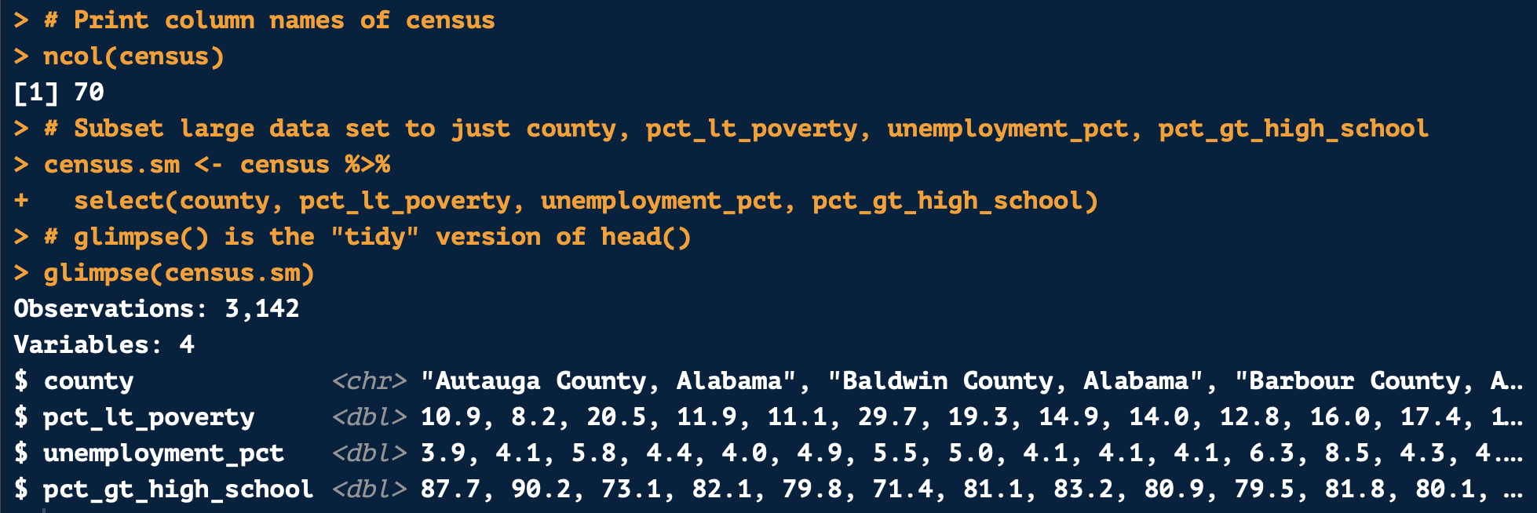
select() Example

Slide 14
More about select()
Can also remove specific variables by adding a - in front of the variable name
Can remove a vector of variables with a - in front
Structure:
Both remove var1, var2, and var3 from a larger set of variables
small.df <- large.df %>%
select(-var1, -var2, -var3)
small.df <- large.df %>%
select(-c(var1, var2, var3))
=

Slide 15
select() Function Helpers
Can use these helper functions with select()
  contains(“string”) to select all variables containing a certain string
  starts_with(“string”) to select all variables starting with a specific string
  ends_with(“string”) to select all variables ending with a specific string
  num_range(“var”, 1:3) to pull var1, var2, and var3
    Starts with var, followed by numbers 1, 2, and 3

Slide 16
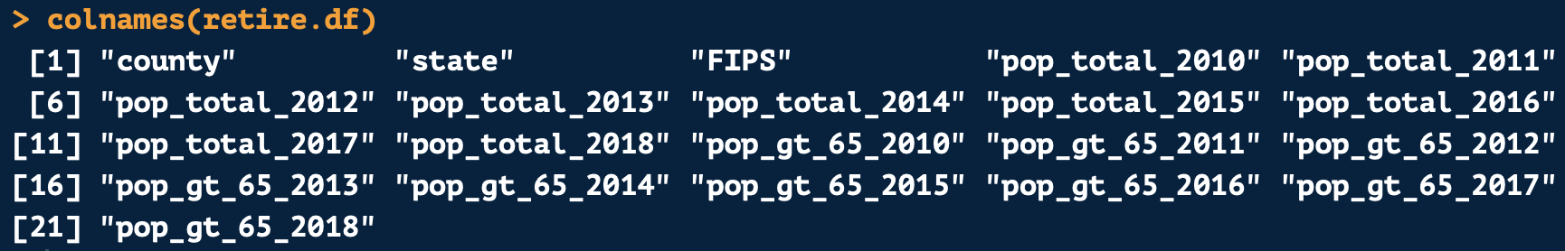
select() with Helper Functions Example
Selects county, state, FIPS, those variables containing the string “total”, and those variables containing “gt_65”

Slide 17
filter() function

Slide 18
The filter() Function
Subsets data based on a variable’s value
Use a rule that will return a logical value of TRUE for observations you want to keep
Structure:
Will select only those rows where the variable equals “value”
subset.df <- full.df %>%
filter(variable == “value”)

Slide 19
More about filter()
You can use more than one condition to subset your data
  Use & to subset to rows that equal ALL listed conditions
  Use | meaning OR to subset to those rows that equal one of the conditions you list
Use != to subset to those rows NOT equal to a value
Structure:
subset.df <- full.df %>%
filter(variable1 == “value1” | variable2 == “value2”)
subset.df <- full.df %>%
filter(variable1 != “value1” & variable2 != “value2”)

Slide 20
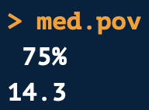
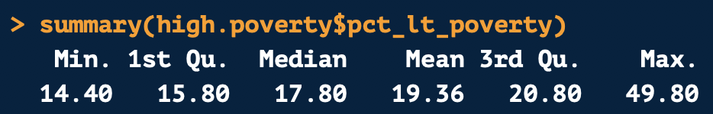
filter() Example
Found median % less than the federal poverty line
Subset data to counties greater than the median
New data distribution

Slide 21
arrange() function

Slide 22
arrange() Function
Allows you to sort a data frame by one or multiple variables
Will sort by default in ascending (getting larger) order
To sort in descending order put a hyphen before the variable name
Structure:
sorted.df <- original.df %>%
arrange(var1, var2, var3)

Slide 23
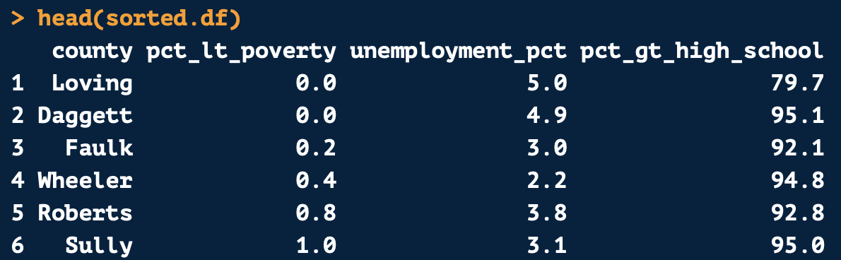
arrange() Example
Sort by:
  pct_lt_poverty (ascending)
  unemployment_pct (descending)
  pct_gt_high_school (ascending)

Slide 24
Chaining dplyr Code

Slide 25
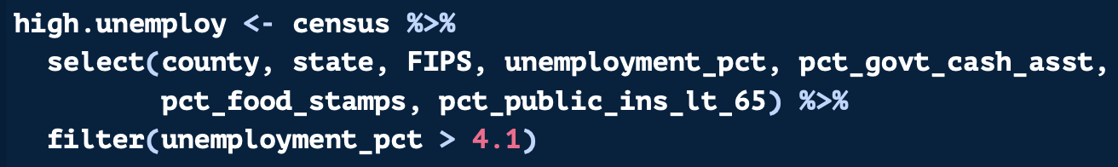
Chaining dplyr Functions
Can chain multiple functions together with the %>%
Original data frame to manipulate
chained.df <- original.df %>%
select(var1, var2, var3) %>%
filter(var1 == “value1”)
Selecting smaller number of variables
Results from select function into the filter function

Slide 26
Chaining Functions Example
First, the code selects a subset of variables from the census data frame
Second, the smaller data frame is filtered to only include unemployment rates above 4.1

Slide 27
mutate() function

Slide 28
mutate() Function
The mutate() function allows you to create new variables
New variables can be calculated with other variables
You can use if/else and case when statements to create new variables with mutate
Structure:
new.df <- original.df %>%
mutate(new.var = var*100)

Slide 29
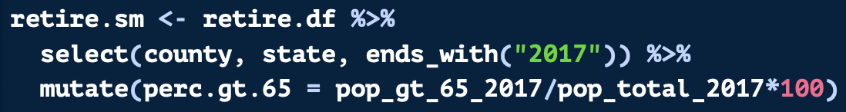
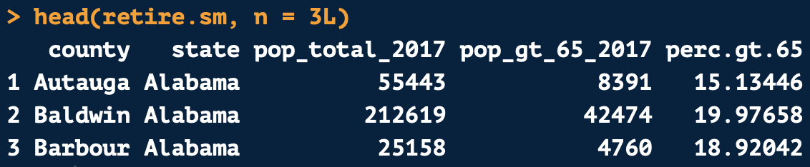
mutate() Example
The following code creates a percent of the number of individuals in the population that are over age 65
We use the mutate() function to calculate this new variable

Slide 30
Using if_else() with mutate()
There is a dplyr version of the if_else function
Can be used inside the mutate() function
Just as you do with the base R ifelse() function, insert a logical rule
The first argument is what to set if the value is TRUE
The second argument is what to set if the value is FALSE
Structure:
new.df <- original.df %>%
mutate(gt.5.var = if_else(value > 5,
“Greater than 5”, “Less than or equal to 5”))

Slide 31
Using case_when() with mutate()
case_when() is used in mutate instead of nesting multiple if_else() functions
Just as you do with the base R ifelse() function, insert a rule
After the rule add a ~ and then the value to use if the rule is TRUE
Separate each rule and value with a comma
Structure:
new.df <- original.df %>%
mutate(high.med.low = case_when(value < 5 ~ “Low”,
value >= 5 & value <= 10 ~ “Medium”,
value > 10 ~ ”High”)

Slide 32
Else with case_when()
After creating rules, if you need to designated all other values to a group, add a TRUE statement as shown below in orange
Note: If your ”else” value is NA, you will have to transform the NA value to the same data type as your other groups
Structure:
new.df <- original.df %>%
mutate(high.med.low = case_when(value < 5 ~ “Low”,
value >= 5 & value <= 10 ~ “Medium”,
value > 10 ~ ”High”,
TRUE ~ as.character(NA))

Slide 33
R Code Example

Slide 34
Grouped Summary Statistics

Slide 35
Creating Grouped Summaries
You can create grouped summaries easily in dplyr
First use the input data frame followed by a pipe %>%
Use the group_by() function with the variables you want to group by
After another %>% use the summarize() function with any summary variable
You can only use functions that calculate one value for each group
new.df <- original.df %>%
group_by(grouping.variable) %>%
summarize(mean.of.groups = mean(var.of.interest, na.rm = T))

Slide 36
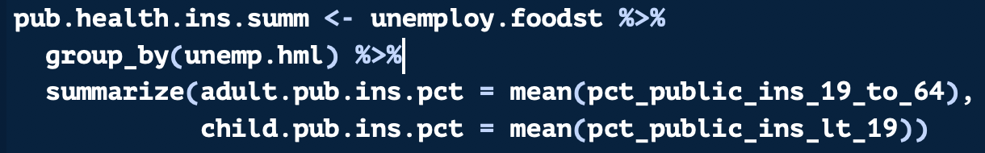
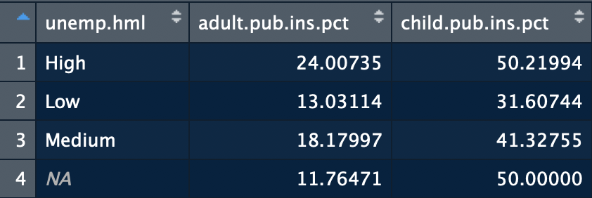
Grouped Summary Example
Below the code is grouping by unemp.hml
For each group, we are finding the mean of pct_public_ins_19_to_64 and pct_public_ins_lt_19

Slide 37
Retaining Variables with group_by()
The group_by() and summarize() functions will only keep the summary statistics and the grouping variables in the final data frame
If you want to calculate grouped statistics and retain all variables, use mutate() instead of summarize()
Will set the same summary value for all members of a group
Retains the structure of the original data frame
new.df <- original.df %>%
group_by(grouping.variable) %>%
mutate(mean.of.groups = mean(var.of.interest, na.rm = T)

Slide 38
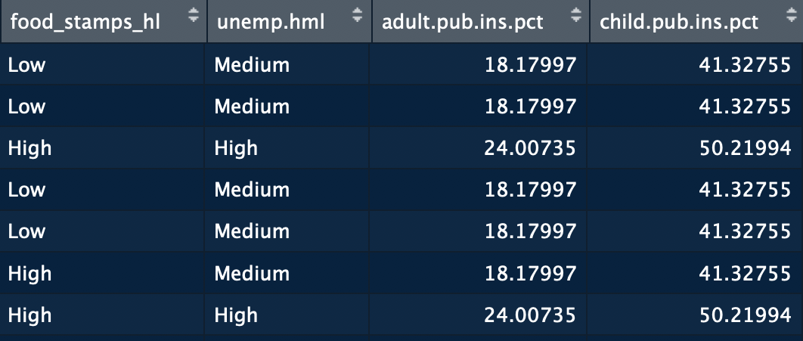
group_by() with summarize() vs mutate()
group_by() with summarize()
group_by() with mutate()

Slide 39
dplyr Joins

Slide 40
Joining with dplyr
The dplyr package has separate functions for the different types of joins
Each join has different attributes shown on the next slide
You can specify the variables to join by using a by statement
By default, the functions will join based on all variables with the same variable names
new.df <- inner_join(dataframe1, dataframe2, by = c(“var1”, ”var2”))

Slide 41
Multiple Joins in dplyr
You can perform multiple consecutive joins easily with dplyr
The results from the first join are placed into the second join where you place the period
Structure:
new.df <- inner_join(dataframe1, dataframe2) %>%
full_join(., dataframe3)

Slide 42

Merge Function | Keeps All Rows | Keeps All Rows in R & Matching Rows in L | Keeps All Rows in L & Matching Rows in R | Keeps Only Rows in Both R & L | Keeps Only Non-Matching Rows | Keeps Duplicate Rows | Removes Duplicate Rows | Keeps All Columns | Keeps Only Columns in R
inner_join()
full_join()
right_join()
left_join()
semi_join()
anti_join()

Slide 43
Join Coding Example

Slide 44
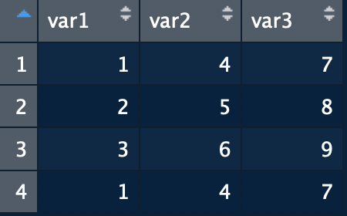
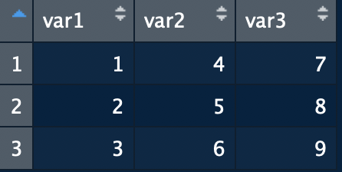

distinct(.)
If you know you have duplicate rows in your data, chain distinct(.) to the end of your dplyr code to remove them
Structure:
no.dup<- duplicate.df %>%
distinct(.)
duplicate.df
no.dup

